Slide 1
Knowledge Organiser
NCFE CACHE: Level 1-2 Technical Award in Health and Social Care
Content area 1: H&Sc Provision and Services
Content area 2: Job Roles in Health and Social Care
Statutory - These are services that have to be available by law, i.e. through legislation which requires either the government or local authorities to provide them. | Private - These are profit-making services. They will be run by a owner or company. | Voluntary - These are services that are usually run by a charity, where some or all of their funding comes from donations. | Informal - unpaid care provided by someone who has a personal relationship with the individual
Healthcare Social care
Title | Job role: Healthcare | Title | Job role: Social Care
Nurse | collaborates with teams to plan patient care, monitors and records the individual’s health status, administers medication and supports holistic care needs | Social worker | works in partnership to assess and support individuals in need to safeguard and protect from harm
Doctor Hospital/GP based. | diagnoses and treats physical and mental health conditions | Care assistant | provides holistic care to meet the individual’s needs
Paramedic. | responds to emergency calls in the community, assesses the individual and provides life-saving medical intervention | Speech & Language therapist | provides support for individuals with communication difficulties and individuals with eating, drinking and swallowing problems
Physiotherapist | assesses and supports the individual affected by injury, illness or disability through tailored exercise programmes, manual therapy and advice | Outreach worker | provides emotional and practical support to individuals within the community to help them take part in all aspects of everyday life
Occupational Therapist | assesses and supports the individual’s physical, psychological, social and environmental needs and provides adaptations | Family Support Worker | establishes relationships with individuals and families in need to provide tailored support
Dentist | assesses oral health and provides dental treatment | Activities coordinator | organises activities to support the holistic wellbeing of the individual
Pharmacist | dispenses medication and advises on the individual’s health issues | Social Care prescriber | signposts individuals to community support for wellbeing
Dietician | assesses and provides nutritional advice to promote a balanced diet
Specialist community public health nurse e.g. health visitor | supports and promotes health and development of children and families
The purpose of Health and Social Care services
• provide a standard of care to meet government legislative and regulatory requirements
• provide types of intervention specific to the individual’s needs and preferences
• provide individualised care to meet long- and short-term needs and preferences
Health Care Services | Functions
Hospitals | O A&E treatment/ aftercare o treatment of infection, diseases, conditions o operations for identified conditions o follow up: outpatient dep’t/ clinics o health and wellbeing centres
GP Surgeries | o consultations o minor surgery o practice nurse services o clinical advice and diagnostics o referral to other services o guidance on healthy lifestyles
Clinics | o mobile screening o family planning services o addiction services o sexual health services
Pharmacies | o non-emergency medical advice o dispensing services o non-prescription medication
Dental services | o regular and emergency treatment o oral health advice o referral to hospital services
Ambulance services | emergency assessment and transfer to hospital o initial treatment to stabilise a condition o transport services from home to clinics
Social Care Services | Functions
residential services provide long-term care: | care homes for adults, children and young people provide: ▪ 24-hour support and care for an individual with particular needs
foster care provides short- and long-term care: | day to day care to support wellbeing, education and to advocate on behalf of the child or young person
respite services provide short-term care: | hospice, respite holiday, day care, sitting services provide: ▪ a short break for families in need
community services are targeted services to meet local need: | community centres, family centres, homecare services provide: ▪ a local service to promote wellbeing, meet a range of individual needs and support the individual’s independence

Slide 2
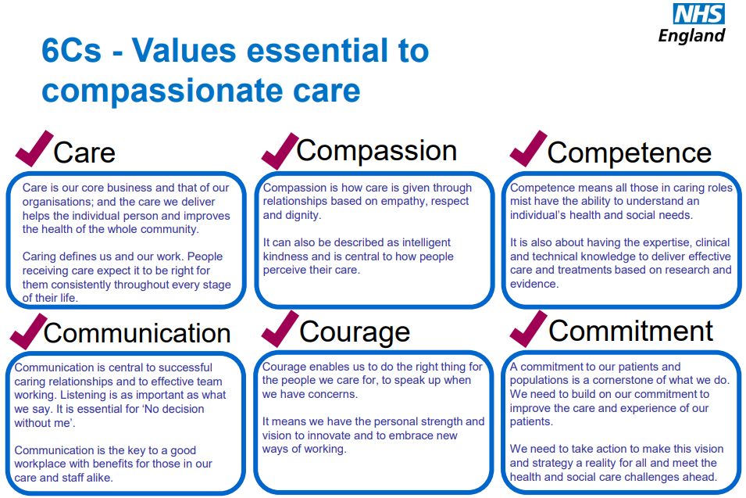
Knowledge Organiser
NCFE CACHE: Level 1-2 Technical Award in Health and Social Care
Content area 2: Job Roles in Health and Social Care
Continued: CPD – Continued Professional Development
Care Values
Health and Social care values which underpin professional practice are integral to person-centred practice. They are standards which help to guide professionals in providing the most appropriate care.
Commitment .
Compassion
Communication
o care: consistent tailored care throughout life
o compassion: how care is underpinned by emphatic, respectful and dignified relationships
o competence: delivery of evidence-based care and treatment
o communication: key to caring relationships and facilitating team working
o courage: raise concerns and be open to innovative ways of working
o commitment: dedicated to improving care and experience of the individual and embrace future challenges
continuing / continued professional development (CPD) = engaging in activities to develop and enhance both personal and professional skills
This helps the practitioner to manage their own learning and growth throughout their career.
Importance of CPD:
o ensures knowledge and practice is current
o meets regulatory requirements
o ensures the quality of care
o improves outcomes for the individual or service
o enhances professional and personal growth of the practitioner
This continuous learning helps to open new doors (promotions or career progression), keep the practitioners skills and knowledge up to date to ensure they are practicing safely and legally.
6Cs:
Courage
Care.
Competence
• duty of care: maintains legal requirement to protect the individual and act in their best interests
• safeguarding: ensures safety of the individual and protects from harm and abuse
• dignity: promotes the individual’s self-respect
• respect: acknowledges diversity through recognising and responding to the individual’s needs and preferences
• rights: promotes entitlements set out in law
• confidentiality: maintains privacy and security of personal information
• independence: enables the individual to make own decisions

Slide 3
Knowledge Organiser
NCFE CACHE: Level 1-2 Technical Award in Health and Social Care
Content Area 3: Legislation, Policies and Procedures
Regulatory and Inspection bodies
Care Quality Commission - regulates health and adult social care services | OFSTED - regulates education, children’s services and schools | HCPC - register of health and care professionals | NMC - register of health and care professionals | Social Work England register of those who can practice social work
Legislation
Equality Act 2010
HASAWA 1974
Data Protection Act2018
H&SC Act 2012
Care Act 2014
Key roles of regulatory/inspection bodies: o uphold standards o ensure public confidence o register services o monitor, rate and inspect services o protect the individual
Key roles and responsibilities of the practitioner o understand the related legislation, policies and procedures o adhere to the underpinning policies and procedures o work within own professional boundaries o understand how to escalate any concerns o allow for access to quality health and social care services
defines protected characteristics: age, disability, gender reassignment, marriage and civil partnership, pregnancy and maternity, race, religion or belief, sex, sexual orientation
defines responsibilities for maintaining health and safety at work
defines data protection principles which require fair, lawful, and transparent handling and processing of personal information
defines the planning, delivering and monitoring of healthcare services
defines duties in relation to assessment of needs and their eligibility for publicly funded care and support
Content Area 4: Human Development across the Lifespan
Through the life span, development is refined and often areas of development decline as a result of the ageing process or disease: ·holistic development: sees the individual as a whole person where all areas of development are incorporated ·interdependency: the relationship and the dependency of each area of development and its impact on the individual’s wellbeing
Procedures in relation to the following policies:
Inclusion Policy | Health and Safety | Confidentiality
inclusive practice which promotes: ▪ a person-centred approach ▪ dignity ▪ respect | risk management: ▪ risk assessment | information management: ▪ sharing information: • gain consent • need to know basis ▪ storage of information: • maintain secure environment • password protected • locked filing cabinet reporting and recording: ▪ timely ▪ factual ▪ legible
equal access which ensures: ▪ non-discriminatory practice ▪ barriers to access faced by the individual are overcome ▪ adaptations to environment are put in place to meet the individual’s needs and preferences ▪ aids and equipment are secured to meet the individual’s needs and preferences | infection prevention and control: ▪ hand washing ▪ use and disposal of personal protective equipment (PPE) ▪ disposal of waste and body fluids security: ▪ security checks: identity and the environment
valuing diversity which ▪ celebrates individual differences: values, beliefs, traditions | manual handling: ▪ correct moving and handling techniques accident and incident: ▪ reporting and recording ▪ emergency evacuation
Transitions: Changes from one stage to another in the individual’s life. Can be expected/unexpected
Infancy (0-2 years) Start nursery | Childhood (3 – 10y) - Arrival of new sibling | Adolescence (11 – 17 y) o onset of puberty o sitting examinations o leaving home | Early Adulthood (18 – 29 y ) Middle adulthood (30 – 60) Late adulthood (60+)Vo employment O marriage/civil partnerships O parenthood O divorce O bereavement O retirement O diagnosis of medical conditions
Health and safety procedure
risk assessments
Security checks
Safety of equipment
First aid procedures
Report incidents/accidents
Hygiene routines
Follow emergency and fire evacuation procedures
Safe disposal of bodily fluids and waste
Manual handling safety
Equality and Inclusion Procedure
recognise and celebrate individuals
Ensure dignity and respect
Reasonable adjustments
Appropriate resources
Adapt materials
Positive images
Treating every equally
Meeting individual needs
Ensure anti-discriminatory practice
Safeguarding Procedure
Protecting children
Physical abuse
Emotional abuse
Sexual abuse
Neglect
How to respond and report
Confidentiality Procedures
Build trust between all hose involved
Safeguarding
Legal requirement
Privacy
Obtain consent/permission
‘Need to know; principle

Slide 4
Knowledge Organiser
NCFE CACHE: Level 1-2 Technical Award in Health and Social Care
Content Area 4: Human Development across the Lifespan
Factors which may impact human development
Biological
o inherited characteristics and health conditions e.g. Cystic fibrosis, PKU, Down Syndrome, Susceptibility to: cancer, high blood cholesterol, diabetes
Environmental
o lifestyle: way of living; the things that a person or particular group of people usually do
▪ rest
▪ physical activity
▪ diet
▪ drugs and alcohol
o socio-economic: differences between groups of people relating to their social class and financial situation
▪ education
▪ employment
▪ income
o relationships:
▪ family
▪ partners
▪ friendships
o culture: Culture encompasses religion, food, what we wear, how we wear it, our language, marriage, music and is different all over the world.
▪ values
▪ traditions and expectations
o physical environment:
▪ urban
▪ rural
How the practitioner can prepare & support the individual for transition: • building and maintaining positive relationships with the individual • involving the individual in planning for the transition • discussing exploring and reassuring the individual in relation to the transition • working in partnership with the individual, relevant others and other practitioners • providing information and advice, signposting the individual to appropriate services referring the individual for specialist support as required.
Lifestage Age (years) | Physical Development | Cognitive Development | Emotional Development | Social Development
Infancy 0-2 years | ▪ can sit ▪ can roll over ▪ can walk | ▪ learns and responds through senses ▪ points to body parts ▪ language develops (E.g. babbling, single words, range of 200 words) ▪ responds to simple command | ▪ attachments form with main carer ▪ may develop temper tantrums | ▪ waves ‘bye-bye’ ▪ communicates by smiling ▪ can become wary of strangers
Childhood 3-10 years | ▪ can stand on one leg ▪ can ride a tricycle ▪ cut along a line ▪ legible handwriting ▪ confident handling equipment during sports ▪ greater coordination/ peed with fine & gross motor skills | ▪ develops pre-reading then reading skills ▪ problem solves ▪ gives reasons for actions ▪ talks with increasing fluency and confidence | ▪ shows affection for younger children ▪ develops fairness and sympathy for others | ▪ willing to share toys ▪ can enjoy team games ▪ often has a ‘best friend’
Adolescence 11 – 17 years | ▪puberty & sexual maturity reached ▪ muscle mass increase ▪ changes body shape/ height | ▪ develops complex thinking skills ▪ memory functions efficiently ▪ has ability to think, reason and make choices | ▪ mood swings are common ▪ development of more intimate relationships ▪ can become self-conscious ▪ influenced by views, opinions and behaviours of friends (peer pressure) | ▪ increasing independence from parents ▪ friendships become very important
Early adulthood 18 – 29 years | ▪ full height is reached ▪ body strength at maximum | ▪ application of analytical skills to work environment/home ▪ becomes more established in the workplace | ▪ stress due to work, finances and relationship problems ▪ emotional bonds may form with partners and own children | ▪ relationships form with people from work ▪ friends and social relationships often change
Middle adulthood 30 – 60 years | ▪ menopause occurs ▪ loss and greying of hair ▪ muscles start to lose strength | ▪ cognitive thinking begins to decrease ▪ has range of life experiences which may affect future | ▪ changes in relationships ▪ feelings of loss when children leave home ▪ period of self-doubt and mid-life crisis | ▪ relationships with grandchildren are important ▪ friendships continue from school, through work and outside activities
Late adulthood 60+ years | ▪ decline in mobility ▪ visual and hearing degeneration ▪ loss of bone density | ▪ short-term memory loss ▪ decline in attention span | ▪ loneliness due to isolation ▪ less anxiety in life due to no work pressure ▪ self-esteem and confidence may decrease ▪ anxiety over reduced income and care costs | ▪ can develop new relationships through new interests ▪ isolation due to lack of social contact in the workplace

Slide 5
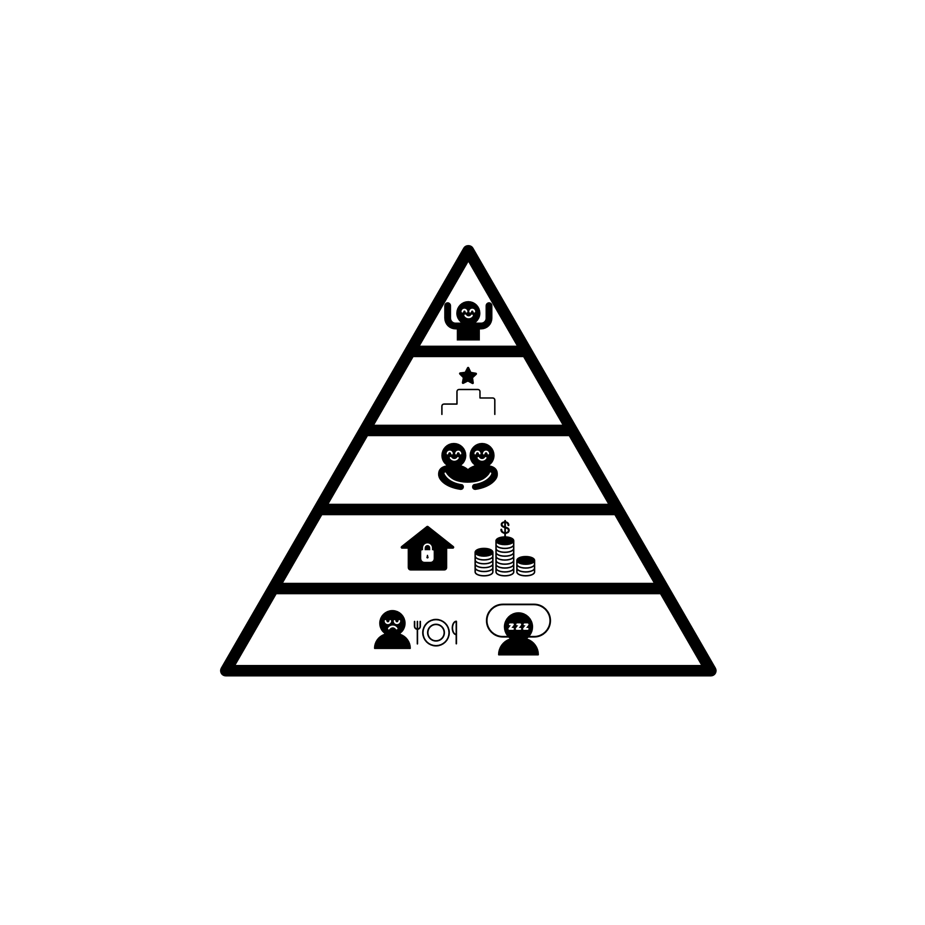
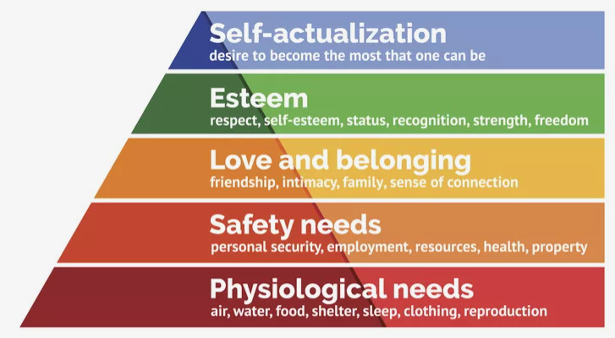
Knowledge Organiser
NCFE CACHE: Level 1-2 Technical Award in Health and Social Care
Content Area 5: The care needs of the individual
How conditions and disabilities may impact on care needs
Physiological and biological requirements for human survival | o food and drink: ▪ ability to prepare food and drink ▪ ability to meet own nutritional requirements ▪ ability to eat and drink unaided o rest and sleep: ▪ disruption to sleep pattern o personal care: ▪ toileting: • incontinence because of a health condition • incontinence because of mobility ▪ ability to care for skin, hair and teeth ▪ ability to dress/un-dress ▪ ability to select clothing for the season
Safety, security and control | o environment: ▪ ability to maintain own safety ▪ ability to maintain own security o healthcare: ▪ ability to access services and treatment ▪ ability to manage own medication o emotional security: ▪ ability to cope with anxiety and stress ▪ level of resilience o financial security: ▪ employment status ▪ available funds to maintain lifestyle and meet needs
Love and belonging | o maintain active relationships: ▪ with family, partners, friends and community ▪ level of involvement with others ▪ level of isolation and loneliness
Esteem, dignity and respect for others | o self-confidence: ▪ level of self-confidence o independence: ▪ level of dependency: • ability to self-care:
Self-actualisation and realisation for full potential | o personal growth: ▪ ability to achieve own potential o self-fulfilment: ▪ desire to achieve own potential
Maslow’s Hierarchy of Needs
Conditions and disabilities that require health and social care support
chronic condition: a physical or mental condition which is long-lasting in its effects (lasts at least 3 months but usually lasts a year and is often life-long)
acute condition: a physical or mental condition which is of short duration, intense, develops quickly but generally has no lasting effects
disability: physical or mental condition that has a substantial (more than minor) and long-term (12 months+) impact or effect on an individual’s lifestyle (Equality Act 2010)
o types of disability include: ▪ cognitive ▪ physical ▪ mental ▪ sensory
Care Values in Practice:
Meal times – o agree with the individual the level of assistance required o provide necessary aids and adaptations to promote independence o ensure safe food handling and preparation is maintained
Personal Care and Toileting o agree support required o meet preferences in choice of care and dressing o provide aids and adaptations to promote independence o ensure privacy and dignity by: ▪ shutting doors ▪ closing curtains ▪ being unobtrusive Activities – o find out the individual’s interests and preferences o involve family, friends and others at the request of the individual o provide activities to meet choices

Slide 6
Knowledge Organiser
NCFE CACHE: Level 1-2 Technical Award in Health and Social Care
Content Area 6: How Health and Social Care Services are accessed
Content Area 7: Partnership working
Different Practitioners working together to meet individual needs
Referral
Improves outcomes: • using the expertise of other practitioners’ knowledge, skills and experience • working together towards shared goals to ensure consistent and continuous care for the individual • clarifying roles and responsibilities of all practitioners • establishing care to meet the individual’s needs and preferences • enabling interventions to meet the individual’s needs and preferences • ensuring safeguarding
Self The individual initiates direct access: ▪ makes an appointment with a health or social care practitioner ▪ attends a walk-in service
Professional o professional initiates access to: ▪ another health or social care practitioner or service
Third Party: Family member or friend supports /makes the referral ▪ accesses a service on behalf of the individual
Barriers to accessing services:
Barriers to Partnership working
COMMUNICATION
▪ level of understanding
▪ level of trust
▪ assumptions
TIME MANAGEMENT ▪ ineffective time management skills ▪ conflicts in priorities ▪ workload
Strategies to overcome the barriers
COMMUNICATION
▪ agree shared goals ▪ be inclusive ▪ avoid use of jargon ▪ build respect and confidence ▪ acknowledge and understand viewpoints of others
TIME MANAGEMENT ▪ establish practitioners’ commitment and availability ▪ select agreed dates, times and venues ▪ use appropriate mode of communication
communication: o barriers that impact on accessing and understanding information: ▪ sensory impairment ▪ cognitive impairment ▪ English as an additional language
overcome barriers: ▪ ensure effective tailored communication skills are maintained by: • providing information in alternative formats • providing access to specialist professional services
culture: o barriers that impact on the individual’s acceptance of medical treatment and support: ▪ values ▪ beliefs
overcome barriers: ▪ ensure inclusive practice to meet the individual’s values and beliefs ▪ ensure practitioner awareness of a range of culture, values and beliefs and their impact on care needs and preferences
Location: o barriers that impact on the individual’s ability to access services: ▪ transport ▪ cost ▪ capability of the individual to access building overcome barriers: ▪ provide community services ▪ provide aids and adaptations ▪ online/telephone consultations ▪ online prescription ordering and delivery

Slide 7
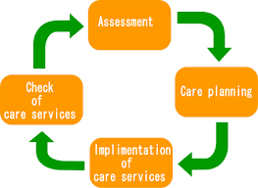
Knowledge Organiser
NCFE CACHE: Level 1-2 Technical Award in Health and Social Care
Content Area 8: The care planning cycle
Exam breakdown – How am I being assessed?
Purpose
o to work with individuals as equal partners when planning and implementing their care
o the individual is central and in control of their care
impact: o builds trust between the individual and the H&SC practitioner o meets the individual’s needs and preferences and establishes support required
o enhances the individual’s confidence and self esteem
o promotes the individual’s independence o empowers the individual
Assessment breakdown |  | 1 hour 30 minutes examined assessment 14 hours non-exam assessment
Non-exam assessment (NEA) | 50% | Externally-set, internally marked and externally moderated: Synoptic project
Examined assessment (EA) | 50% | Externally set and externally marked: Written exam
Total | 100% | Overall grades: Level 1: pass, merit and distinction Level 2: pass, merit and distinction
Care plan ·care plan: a record that outlines the standardised care and support required to meet the individual’s holistic needs and preferences with reference to Maslow’s hierarchy of needs
·holistic needs:
o physical
o cognitive
o social and emotional
Assess (PLAN)
o identify the individual’s needs and preferences
o identify any risks
o discuss and agree care and support required with the individual and relevant others
o communicate agreed outcomes with the individual and relevant others
o record information and outcomes on the individual’s care plan
implement: (DO)
o agree strategies to meet individual’s needs/ preferences o work in partnership with other professionals/services as appropriate
o offer advice / guidance to the individual and relevant others
o obtain required aids and adaptations
o set target / review dates
o carry out agreed care / support to meet the needs and preferences of the individual
o monitor and record information and outcomes on the individual’s care plan
Top Exam Tips
Before the exam
Revision
Plenty of rest/sleep
Manage your time
Exercise
Ask for help
Make a revision timetable
Have enough food and drink
Get organised
Arrive early for exam
During the exam
Read questions carefully
Answer every question
Use all the time you have been provided
Re-check your answers if you have spare time
Highlight keywords if you find it helpful
Be positive
Stay calm
Stages of the cycle:
Assess, Implement, Monitor, Review(Modify)
Review o observe the extent to which the individual’s needs and preferences have been met o agree any changes required

