Slide 1

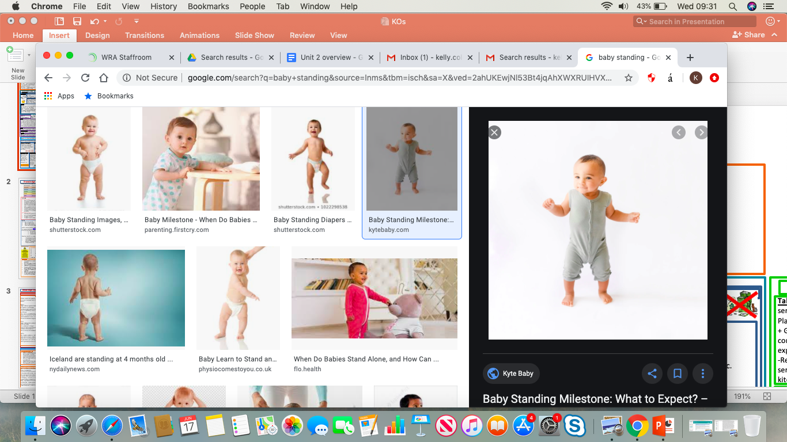
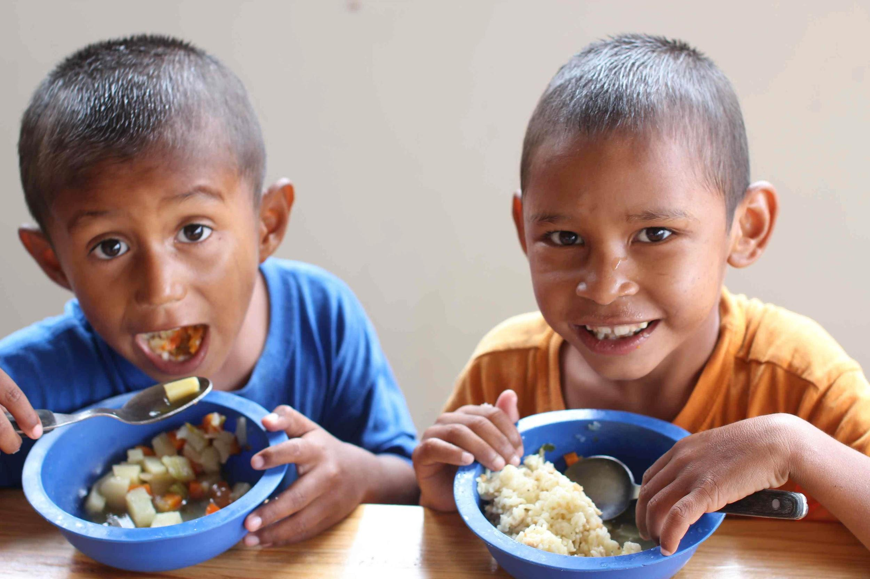
Knowledge Organiser
NCFE CACHE: Level 1-2 Technical Award Child Development & Care in the Early Years
Content area 1: Child development
Content area 2: Factors that influence the child’s development
Physical Development
Movements, balance and co-ordination
Fine motor – small movements often made using hands, such as picking up a spoon or using a pencil
Gross motor – large movements such as running balancing & throwing.
Communication and Language development
Talking, listening & understanding. Reading & writing for older children.
Receptive language – what children can understand
Expressive language – what children can say
Social & emotional development
Relationships with others, managing feelings, confidence & self-control
Attachment – a close bond between the child & their parents
Bonding – the process by which children & parents develop a strong loving relationship
Cognitive development
Thinking, memory & understanding concepts such as time, colour & number
Object permanence – the ability to understand that objects when placed out of sight are still in existence
Trial by error – seeing what happens after an action has been made & learning from it.
Nature: Biological. Nurture: Environmental
Biological Factors | Example | Environmental factor | Example
Physical traits – some are linked to genetic inheritance. | Height, physical strength, face shape, eye colour. | Love & interaction – children thrive if they feel loved & have plenty of positive attention from the adults who care for them. | Cuddles, time to talk, being spoken to positively, being listened to.
Medical conditions - most are linked to genetic inheritance. | Diabetes, asthma, sickle cell anaemia. | Stimulation & play – children benefit if there are opportunities to play, talk and do different things. | Going to different places, doing different things, playing with adults and other children, sharing books.
Learning difficulties – are most likely as a result of genetic inheritance. | Autistic spectrum conditions, dyslexia. | Physical conditions/ socio-economic – Children need shelter, warmth and to be physically safe. They also need room to move and explore. | Warm home, opportunities to go outdoors, space to play indoors.
Disabilities – some are linked to genetic inheritance, whilst others may occur during pregnancy and birth | Deafness, sight problems, cerebral palsy, spina bifida. | Food & drink – children need food & drink that is nutritious and healthy. This helps them to grow and have the energy to explore, move and learn. | Developing good food habits including enjoying vegetables and foods high in nutrients.
Personality & temperament | Shyness, curiosity, outgoing | Family Lifestyle: | Abuse, neglect, drug/alcohol abuse, healthy diet, poor diet.
Pregnancy & birth – how healthy a mother is during pregnancy can affect a child’s development | German measles, fetal alcohol syndrome, spina bifida, developmental difficulties. | Personal factors are about inherited traits and also what happened before and immediately after you were born. External factors are about where and how you grew up. They also include the events and experiences that you have had.
Expected pattern of Physical development.
Fine motor
At birth:
hands are firmly closed
Often fold their thumb under fingers
1 years:
Clasps hands together
Points using index finger
2 years:
Draws lines, dots and circles
Separates interlocking toys
3 years:
Fastens large zip
Begins to show preference for dominant hand
4 years:
Begins to fasten buttons
Uses spoon and fork well to eat
5 years:
Can use a knife and fork
Can thread small beads
Gross Motor
At birth:
Lies with head to one side
Head lags when pulled to sitting position
1 year
Sits down from standing
Is more mobile
2 years
Runs with control
Throws and kicks a ball
3 years
Can walk backwards and sideways
Jumps with both feet
Expected pattern of communication and language development
At birth:
Cries to indicate needs
Recognises main caregiver’s voice
1 years:
Understands simple frequent words
Babbles leading to spoken words
2 years:
Uses 50 words or more
Refers to self by name
3 years:
Uses 200 words or more
Joins in simple rhymes
4 years:
Enjoys telling and sharing stories
Can be understood easily by others
5 years:
Shows signs of reading
Concentrates and maintains attention
Expected pattern of social and emotional development.
At birth:
Expresses pleasure when being fed
Often imitates facial expressions
1 years:
Enjoys simple games
Dependant on others
2 years:
Frustrated when unable to express feelings
May be clingy
3 years:
Expresses emotions
Enjoys playing with others
4 years:
More confident in new situations
Can be sensitive to others
5 years:
Enjoys group play
Has likes and dislikes
Expected pattern of Cognitive development.
At birth:
Turns head towards bright light
Startled by sudden noises
One year
Understand simple instructions
Responds to gestures
2 year
Understands consequences for actions
Names pictures and objects in book
3 years
Recognises objects that are heavy and light
Sorts objects by shape and size
4 years
Counts to 10
Names some colours
5 years
Can count to 20
Understand basic rules
Common Transitions
- Going to a pre-school, nursery or childminder
- Starting school
- Being cared for by a family member
- Going to a club or class
- Changing group or class within a nursery, pre-school or school.
- Arrival of a new baby
- Moving home
- Death or illness of a family member
- Family breakdown e.g. divorce
Impacts of transitions on a child’s development
Language development child not wanting to talk, finding it hard to listen and withdrawing.
Intellectual development concentration, memory may be limited, children need to be interested in what they are learning.
Social & emotional can cause anxiety, behavioural changes,
Physical can be loss of appetite. Sleep patterns, regression
Illness – Stress affects how well children can fight illness. They may get more coughs and colds than usual.
Sleep – When children are stressed, they find it hard to get to sleep or may wake up a lot.
Lack of energy/ interest – Children many not be interested or have the energy to run or explore, this can mean that physical skills are not being practised.
Possible effects of transitions
Holistic Development – Overall development of a child
Transition – a change of place, family circumstance and/or carer.
Feeding – When children are unsure or stressed. They may find it hard to eat or lose their appetite.

Slide 2


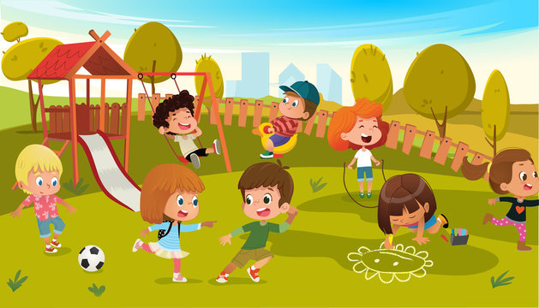
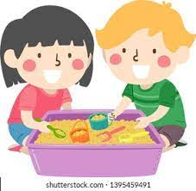
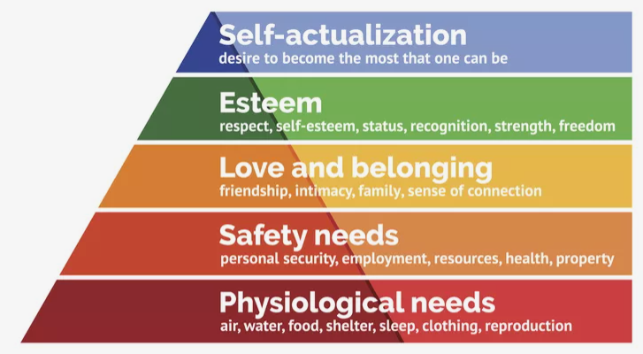
Knowledge Organiser
NCFE CACHE: Level 1-2 Technical Award Child Development & Care in the Early Years
Content Area 3: Care routines, play and activities to support the child
Content Area 4: Early Years Provisions
Statutory - These are services that have to be available by law, i.e. through legislation which requires either the government or local authorities to provide them. | Private - These are profit-making services. They will be run by a owner or company. | Independent - These are services that are provided independently of the state and do not rely on government funding | Voluntary - These are services that are usually run by a charity, where some or all of their funding comes from donations.
Care Routines
Sleep & rest
Physical activity
Balanced diet
Suitable clothing & footwear
Personal hygiene
Safe & stimulating environment
Setting | Description |  |  |  |  | Age
Registered childminder | A registered childminder looks after the children in their own home and is self-employed. They need to be registered and inspected by Ofsted, and offer flexible and individualised care for children. They can look after up to six children between the ages of birth to eight years, including their own. |  |  |  |  | 0-8yrs+
School-based nursery | A school-based nursery will be attached to an infant or primary school They only run during term time. A child may start from two years in an independent school. However, a school-based nursery usually starts the year before the child begins full time education in Reception, so around four years. |  |  |  |  | Varies
Reception class | A school reception class will start during the years of the child’s 5th birthday. Children may start by attending on a half-day basis but will quickly build up to a full day. School-based settings are registered and inspected by Ofsted. |  |  |  |  | 4-5yrs
Children’s centres | They offer a range of different services for children under five and their families. They may be located on school sites or local authority sites. These services also may differ within different areas, but may include health & support for families with young children. They also usually include play centres where parents can attend with their children. |  |  |  |  | 0-5yrs
Day nursery | They must be registered and inspected by Ofsted and are usually open all day. They can be private, voluntary or workplace based. Some will have longer hours and will be open during weekends and evenings. |  |  |  |  | 0-5yrs
Out of school clubs/ play centres | These are clubs which are run for school-age children before and after school, and may run during school holidays. |  |  |  |  | 4+
Parent & toddler group | These are drop-in sessions for parents of young children and are usually run by volunteers and other parents. Parents will have responsibility for their children. |  |  |  |  | 0-3yrs
Playgroup/ pre-school | They may be run by parents or children may be left in the care of staff. If children are left in the care of staff, they must be registered with Ofsted. They are usually run on a voluntary basis during term time and have sessions of around 3 hours. |  |  |  |  | 2-5yrs
Workplace nursery | This provides care and education for children at the place where their parents work. |  |  |  |  | 3 mths+
Nanny | A nanny is a carer who is employed by a child’s parents to look after the child in their own home. Nannies will often look after more than one child if needed and are usually very flexible. However, although many do have training, they are not required to have qualifications. |  |  |  |  | 0-5yrs+
Crèche | A crèche will provide interim care for children from time to time while their parents are engaged in a one-off activity such as shopping, sport, or other activity, usually on the same premises. They are not required to register with Ofsted but can choose to do so. |  |  |  |  | Varies
Variation in Early Years Provision: |  | Accessibility: Cost, eligibility, location, opening times | Capacity: Number of children Ratio of staff to children | Facilities: Indoor & Outdoor environment, Resources | Approach: To learning, Policies, Procedures
Babies and young children need to sleep a lot more than adults. During sleep the body produces a growth hormone.
Children need to be physically active everyday, this helps them have stronger hearts, bones and muscles.
A balanced diet refers to children getting meals & snacks that meet their needs for growth but in the right quantities.
Children need clean clothing and footwear that is right for the weather. If clothes are dirty they could get an infection.
This is keeping skin, hair & teeth clean. Babies and young children’s immune systems are developing, which is why good personal hygiene is vital.
This is important to prevent accidents. Young children are often very impulsive, but they need to have an environment they can explore safely, so they can develop.
Basic Care Needs
Basic Needs | Psychological Needs
Food and drink | Belonging
Fresh air | Affection
Rest and sleep | Sense of achievement
Exercise | Valued
Physical safety
Emotional safety
shelter
Play activities – the way children learn
Physical play
Develops: Balance and coordination, confidence, healthy wellbeing
Creative play
Develops: language, confidence, problem solving
Imaginative play
Develops: communication, relationships, expression of feelings
Sensory Play
Develops: hand eye coordination, concentration, expression of feelings, new concepts
Role of early years practitioner during play activities
Before:
Complete risk assessments, individual needs, planning, outcomes, preparing resources and the environment
Maslow’s Hierarchy of Needs
During:
Engage in open ended talk and discussion, praise and encouragement, manage children’s safety, promote independence, children’s behaviour, encourage socialisation and cooperation between children, adapt activity, ensure inclusion
After:
Tidy up, pack away, reflect on outcomes achieved by children, effectiveness

Slide 3


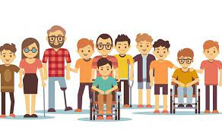
Knowledge Organiser
NCFE CACHE: Level 1-2 Technical Award Child Development & Care in the Early Years
Content Area 5: Legislation, policies and procedures in the early years
Content Area 6: Expectations of the early years practitioner
Behaviour – how you will behave as an early years worker
Role model – Children will copy what you do, so always try to act as you want them to. E.g. when having lunch with a child, ensure you have good table manners.
Positive attitude – smiling, offering to help, going the extra mile
Professional boundaries,
Working within the policies and procedures
Effective communication
Appearance - What you wear and general appearance
Personal hygiene
Body art, piercings, tattoos
Clothing and accessories
Regulatory authority – OFSTED – Part of the government, inspects settings to ensure suitability.
Legislation: A law, or set of laws that have been passed by parliament.
Framework: A set of standards that must be met.
Policy: An action adopted by an organisation.
Procedure: An established way of carrying out a policy.
Timekeeping and attendance
Punctuality
Attendance
Dealing with absence
Act | Policy | Procedure
The Health and Safety at Work Act 1974 – health, safety and welfare of children, staff and visitors within the workplace | Health and safety policy Food and drink policy Visitors to the setting policy | Risk assessments Safe working practices during food prep Reporting accidents Signing visitors in and out
United Nations Convention on Rights of the Child – 1989 – grants all children under 18 the rights | Safeguarding Play policy Equality and diversity | Report abuse (record keeping/reporting) Provide play Adapt activities
Equality Act 2010 – ensures an individual’s characteristics are protected | Equality and diversity | Provide resources that reflect society Good role model Adjust activities
General Data Protection Regulation 2018 (GDPR) – data protection and privacy on how personal data is used and stored | Confidentiality | Share information with consent Store information safely Share information on a ‘need to know’ basis
The Early Years Foundation Stage Statutory Framework (EYFS) | Keyworker Safeguarding Health and safety | Ensure staff/child ratio Respond to disclosure No personal use of mobiles
Content Area 7: Roles and responsibilities within early years settings
Roles
Manager
Early years practitioner
Room leader
Key person
Childminder
Teaching assistant
nanny
Responsibilities
Keeping children safe
Support healthy development
Promote development
Work in partnership
Partnership working: different services and professionals working together with other teams or people to meet the child’s and/or families needs.
How partnership working benefits the child, family and the early years practitioner.
Child: promotes safeguarding, consistent care, interventions, holistic needs
Family: support, shared goals, builds trust
Early Years Practitioner: advice and information, planning activities, trust, shared goals, work together.
Specialist roles inside the setting
SENDCO – Special educational needs and disabilities co-Ordinator
Co-ordinates provision for children with SEN
Responsible for overseeing, assessing, planning, and monitoring progress
DSL – Designated safeguarding lead
Responsible for child protection
Ensures policies and procedures are in place
Makes referrals
Monitors needs of children and families
PANCO – Physical activity and nutrition coordinator
Acts as a champion for best practice
Promotes health and wellbeing
Key person – A requirement of the early years foundation stage (EYFS)#
Works with small groups of children
Offers care to promote children’s growth and development
Specialist roles outside the setting
SEND teams:
physiotherapist – helps and individual affected by injury, disability, illness with movement and exercise, manual therapy, education and advice
Educational psychologist – assesses an individual with special needs, emotional or behavioural difficulties
Health professionals:
General practitioner (GP) – diagnoses and treats medical conditions
Paediatrician – doctor who specialises in the treatment and care of children and young people
Health visitor – works with children and families to support and promote health and development
Children’s social care
Social care – provides assessment of a child and their family needs and offers a range of support to ensure a child is protected and well cared for
Family support worker – provides practical advice and support to the individuals and families in need on a range of issues.
The role of the practitioner in supporting and maintaining these procedures.
Health and safety procedure
risk assessments
Security checks
Safety of equipment
First aid procedures
Report incidents/accidents
Hygiene routines
Follow emergency and fire evacuation procedures
Safe disposal of bodily fluids and waste
Manual handling safety
Equality and Inclusion Procedure
recognise and celebrate individuals
Ensure dignity and respect
Reasonable adjustments
Appropriate resources
Adapt materials
Positive images
Treating every equally
Meeting individual needs
Ensure anti-discriminatory practice
Safeguarding Procedure
Protecting children
Physical abuse
Emotional abuse
Sexual abuse
Neglect
How to respond and report
Confidentiality Procedures
Build trust between all hose involved
Safeguarding
Legal requirement
Privacy
Obtain consent/permission
‘Need to know; principle

Slide 4
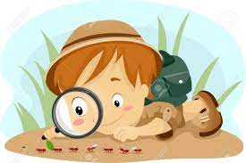


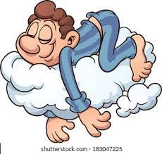
Knowledge Organiser
NCFE CACHE: Level 1-2 Technical Award Child Development & Care in the Early Years
Content Area 8: The importance of observations in early years childcare
Exam breakdown – How am I being assessed?
How observations support child developments
Formative assessment:
Assessments that inform planning and immediate responses to children
Find out the child’s interests
Helps identifies stages of development
Understand triggers in behaviour
Gain insight to share with parents/carers/professionals
Supports provision for the characteristics of effective learning
Plan development activities
Summative assessment:
Assessments that provide a summary of the child’s learning and development at a point in time
Evaluates effectiveness of interventions
Supports assessment of the child’s development
Supports other professionals
Plan learning and development activities
Track progress against current frameworks
Observation: the action or process of closely observing or monitoring something or someone.
Assessment breakdown |  | 1 hour 30 minutes examined assessment 14 hours non-exam assessment
Non-exam assessment (NEA) | 50% | Externally-set, internally marked and externally moderated: Synoptic project
Examined assessment (EA) | 50% | Externally set and externally marked: Written exam
Total | 100% | Overall grades: Level 1: pass, merit and distinction Level 2: pass, merit and distinction
Objective and subjective observations
Objective:
A record of what is seen and heard
It does not include an opinion
It states the facts and details only
It avoids interpretation
Subjective:
Is influenced by past events
Is based on personal experiences
Is based on opinion, feelings and assumptions
Is subject to interpretation
Components of recording observations
Aim: what the observer wants to find out
Recording: the method used, and information gained
Evaluation: an assessment of what has been observed and recorded
Planning: consider what should happen next to support the child and the activities that could support the holistic development
Holistic development: the overall development of a child.
Top Exam Tips
Different methods of observation
Media methods: Make a video recording, take a photograph, record observations in a digital format
Learning journal: Collection of notes, observations and thoughts built up over a period of time
Post-it notes: make a note of a child’s behaviour or skill, temporarily attach a note to a document or surface
Narrative/free description/written account: a short observation focused on the child, write everything down during the period of observation of the child
Checklist: check whether the child can achieve a specialised skills, record findings.
Before the exam
Revision
Plenty of rest/sleep
Manage your time
Exercise
Ask for help
Make a revision timetable
Have enough food and drink
Get organised
Arrive early for exam
During the exam
Read questions carefully
Answer every question
Use all the time you have been provided
Re-check your answers if you have spare time
Highlight keywords if you find it helpful
Be positive
Stay calm
Content Area 9: Planning in early years childcare
Child-centred approach – the approach enables children to initiate and direct their own play with the support of interested and responsive adults.
Purpose of the planning cycle
To identify the individual needs of the child
Physical
Cognitive
Communication and language
Social and emotional
Identify support needs
Establish action planning
Develop partnership working
Refer to other
Planning Cycle
Observe – the child’s holistic growth and development
Assess – compare with expected milestones of development, against current framework expectations, where a child may need support or early intervention
Plan – agree and record what the child needs: additional resources, specific activities, change in routine, referral to other professionals, how practitioners will provide support or early intervention
Implement – put agreed plan into practice, share with other professional and parent/carer, record actions taken
Review - observe the extent to which the needs have been met, make any adjustments to the plan, engage in partnership working, opportunity for practitioner reflection.

Slide 5
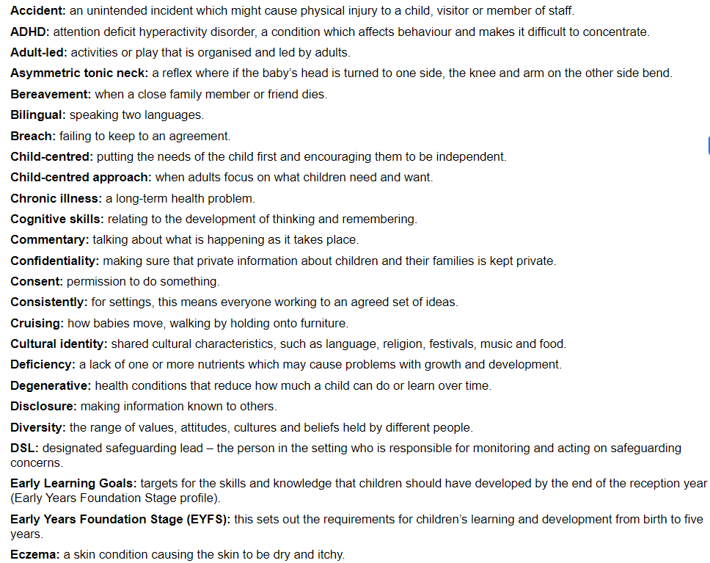
Glossary

Slide 6
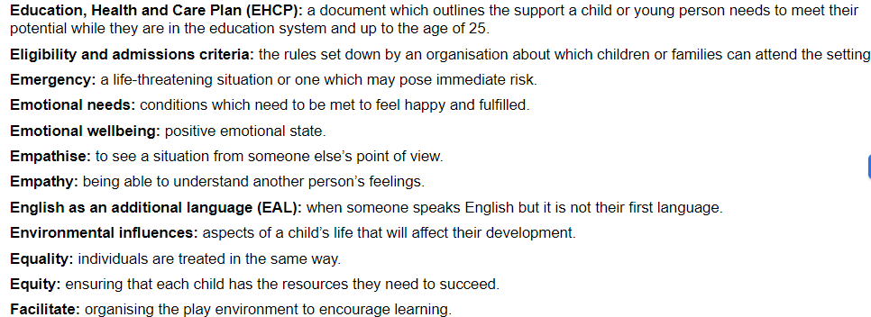
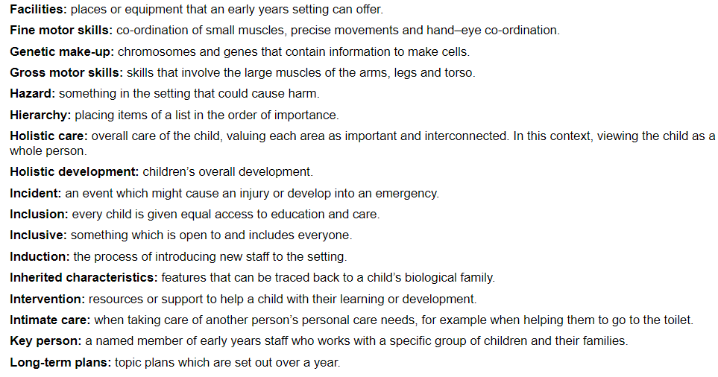
Glossary

Slide 7
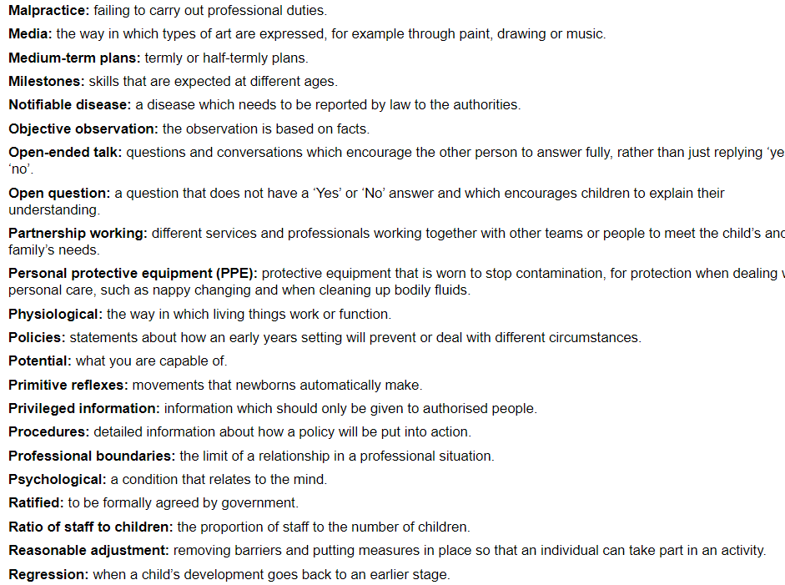
Glossary

Slide 8
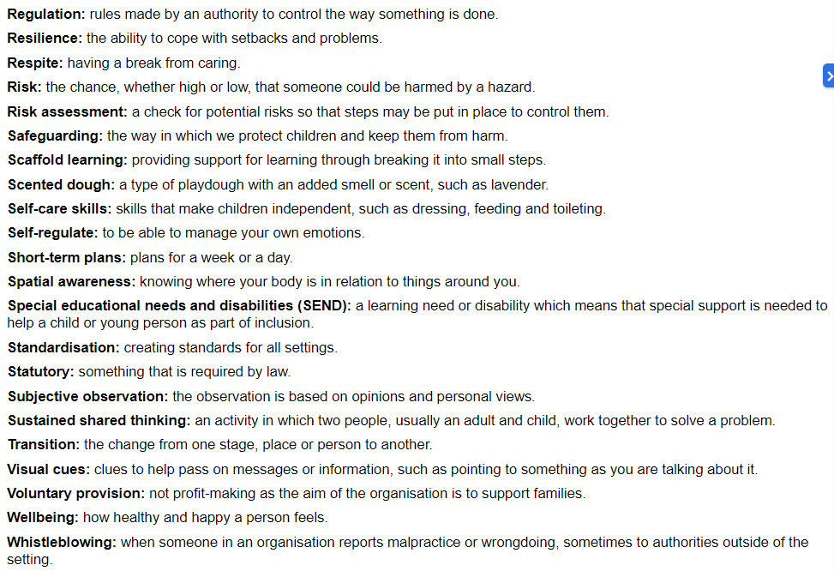
Glossary

