Slide 1
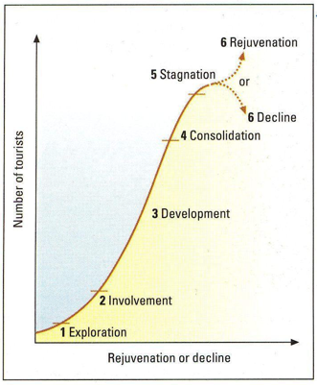
C1:Tourism Developments
Stages of tourism development as suggested by Butler’s Tourist Area Life Cycle (TALC) model.
 | Characteristics of emerging and mature destinations
Emerging destinations – destinations that have recently (within the last ten years) grown in popularity | o visitors seek adventure, ‘authentic’ experience, culture or nature based o may be difficult for overseas visitors to access o transport links likely to be undeveloped o basic infrastructure – energy, water, waste disposal o local people may not have access to healthcare and education o unspoilt natural and cultural features are the main attraction o local communities follow traditional lifestyles o seek to develop tourism to boost economies, raise living standards o low volume of visitors – may have to make own travel arrangements o limited awareness of the destination globally.
Mature destinations – destinations that have been popular for over twenty years | o high volume/mass tourism with organised package holidays o fully integrated transport links o fully developed infrastructure o may be a strain on resources such as water o natural and cultural features may be damaged, diluted, overwhelmed by tourism o established season o extensive advertising of the destination, which is well known globally o standard of visitor facilities may become run-down o local economy is reliant on tourism o may be some conflict between locals and visitors.
Component 3 – Influences on global T & T
LOC Destination Management
Year 11 Term 3
C2: Role of local and national governments in tourism development
Reasons governments may want to develop tourism | maximise the economic benefits of tourism attract foreign currency diversify the economy raise funds to help reduce poverty, improve mobility, healthcare and education create employment opportunities attract funding from foreign investors, private sector improve the quality of life.
How? | tax incentives/tax relief to encourage investment, raise funds considering travel restrictions, security measures and entry requirements, including passport and visa requirements improving transport infrastructure, links and networks – road, rail, air, sea, gateways and hubs improving/establishing essential infrastructure – energy supply, water supply, waste disposal supporting, approving and controlling tourism infrastructure – accommodation, food and drink outlets, communication links – accessibility to the internet, WiFi providing funding for new initiatives in transport, events, training and infrastructure projects that support the local community and/or protect the environment managing destinations by implementing sustainable tourism policies.
C3:The importance of partnerships in destination management
Types
Public and private sector – new tourism developments such as a hotel funded by private sector, local authority may require restrictions on design, size and scale Private sector and private sector – accommodation and transport providers for transfers from airport/train station to accommodation Voluntary and private sector – private sector may assist with the costs of promoting or running an event and in return receive positive publicity Public and voluntary sector – to promote good causes, raise awareness, educate and inform by sharing skills and resources Destination management organisations – bring a range of different organisations together to work on a major project which may be short term or temporary, to raise profile; launch new products; advertise/promote; fund; sponsor – for the benefit of the destination.
Advantages Shared resources, skills, expertise new ideas shared costs increased coverage/publicity/profile. | Disadvantages conflicting aims and priorities less flexibility slows down decision-making process difficulty in responding quickly to changes/events.

