Slide 1
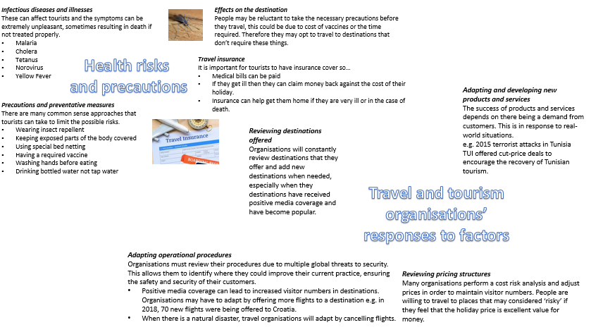
Component 3 – Influences on Global T & T
Year 10 Term 5/6

