Slide 1
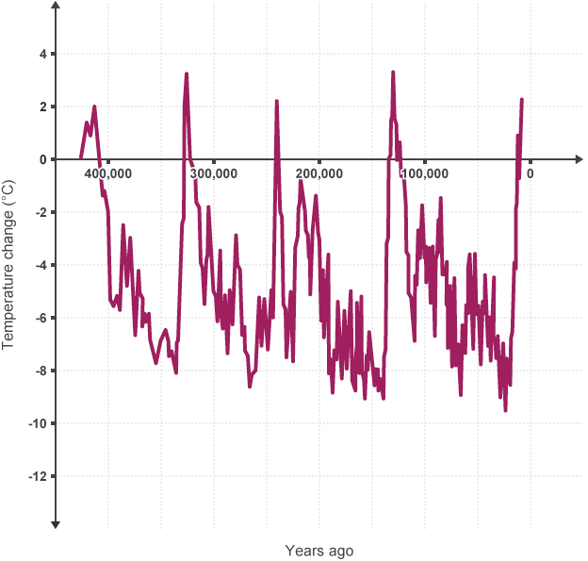
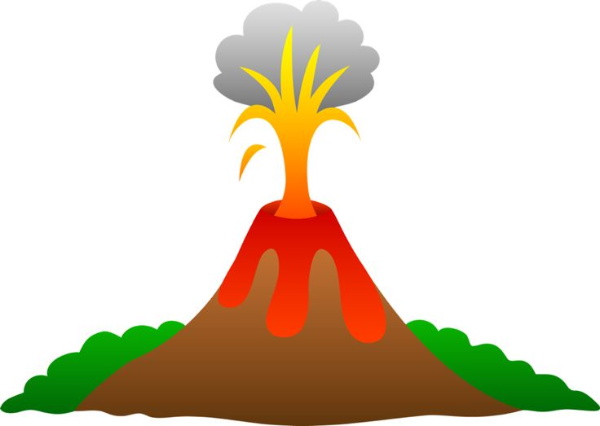
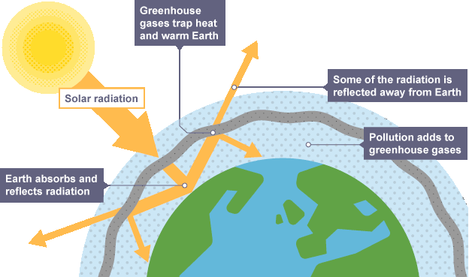
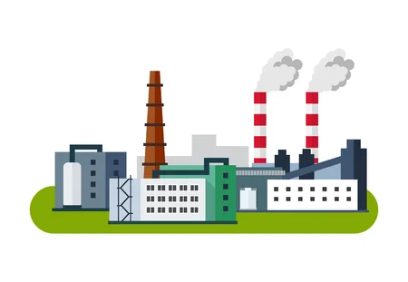
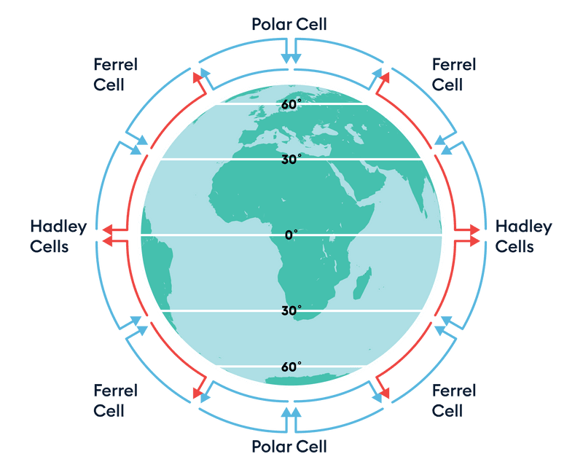
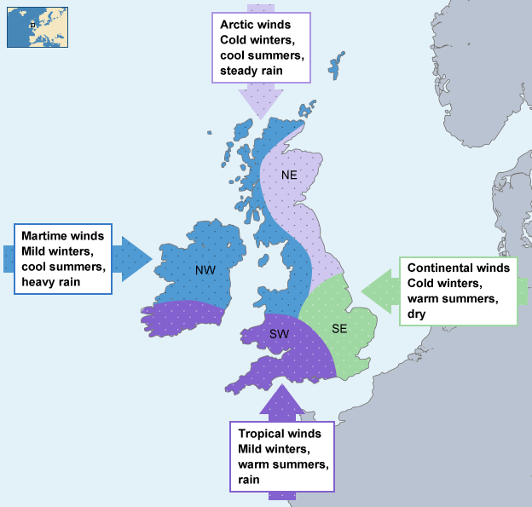
Paper 1 section B Weather Hazards and Climate Change
Climate change
Global temperature has always fluctuated in the last 2000 years. There have been glacial and inter glacial periods.
Natural causes of climate change:
Volcanic eruptions, Sunspots, Milankovitch cycles
Evidence for past climate change is:
Tree rings, pollen records, historical records, ice cores
Weather and Climate key words:
Global circulation – the movement of hot air from areas of surplus (lots of heat) to deficit (less heat) within the Hadley, Ferrel and Polar cells
Coriolis force - a force that causes the air to bend creating winds.
Tropics – 30° north and south latitude
Equator – an invisible line that runs across the centre of the earth marking the area of the earth that receives the most solar energy. It marks 0’ latitude
Natural hazard - a potential threat to lives, the economy and the environment that is caused by the climate or tectonic activity.
Social, economic and environmental impacts – social = relating to people, economic = relating to money/wages, environmental = to do with natural processes.
Human causes of climate change:
-burning fossil fuels in
industry and transport
-agriculture
-energy production
-deforestation
Which all release greenhouse gases such as carbon dioxide and methane. This contributes to the enhanced greenhouse effect.
The greenhouse effect
What causes global and UK climate? The global atmospheric circulation and ocean currents
Impacts of climate change world wide
Retreating glaciers
Reducing crop yields (food shortages)
Rising sea levels
UK’s climate affected by climate change:
Less snow in Scotland so reduced tourism
More flooding in the east of England due to sea level rising
More rainfall/flooding in places like Sheffield due to more evaporation
Heatwaves
Ways to reduce the impact of climate change
Renewable energy
Government agreements
The local factors that affect climate are; altitude, relief

Slide 2
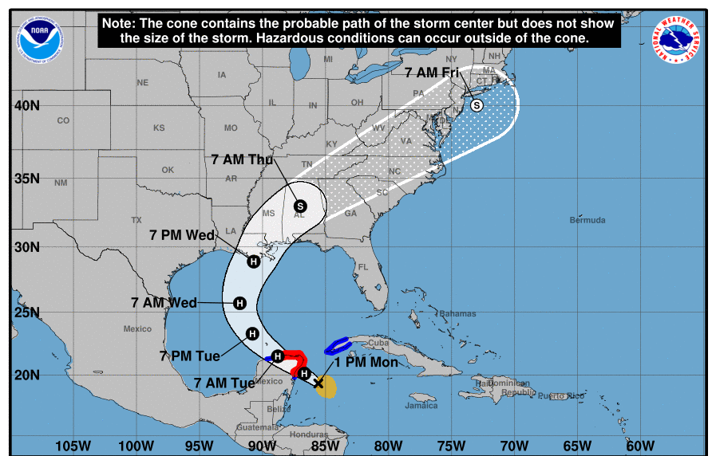
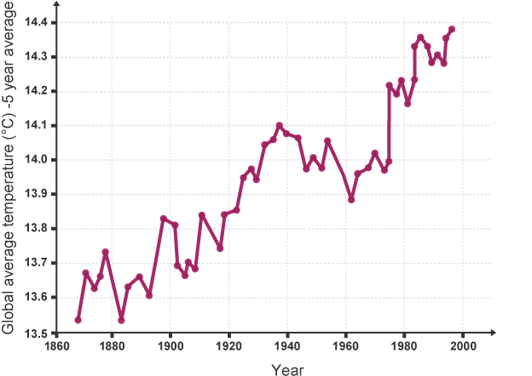
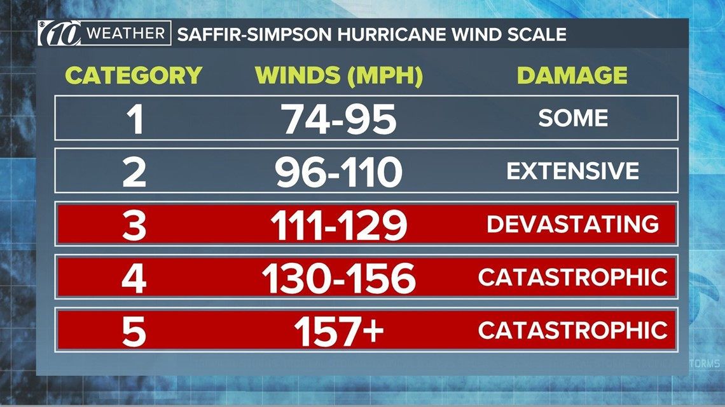
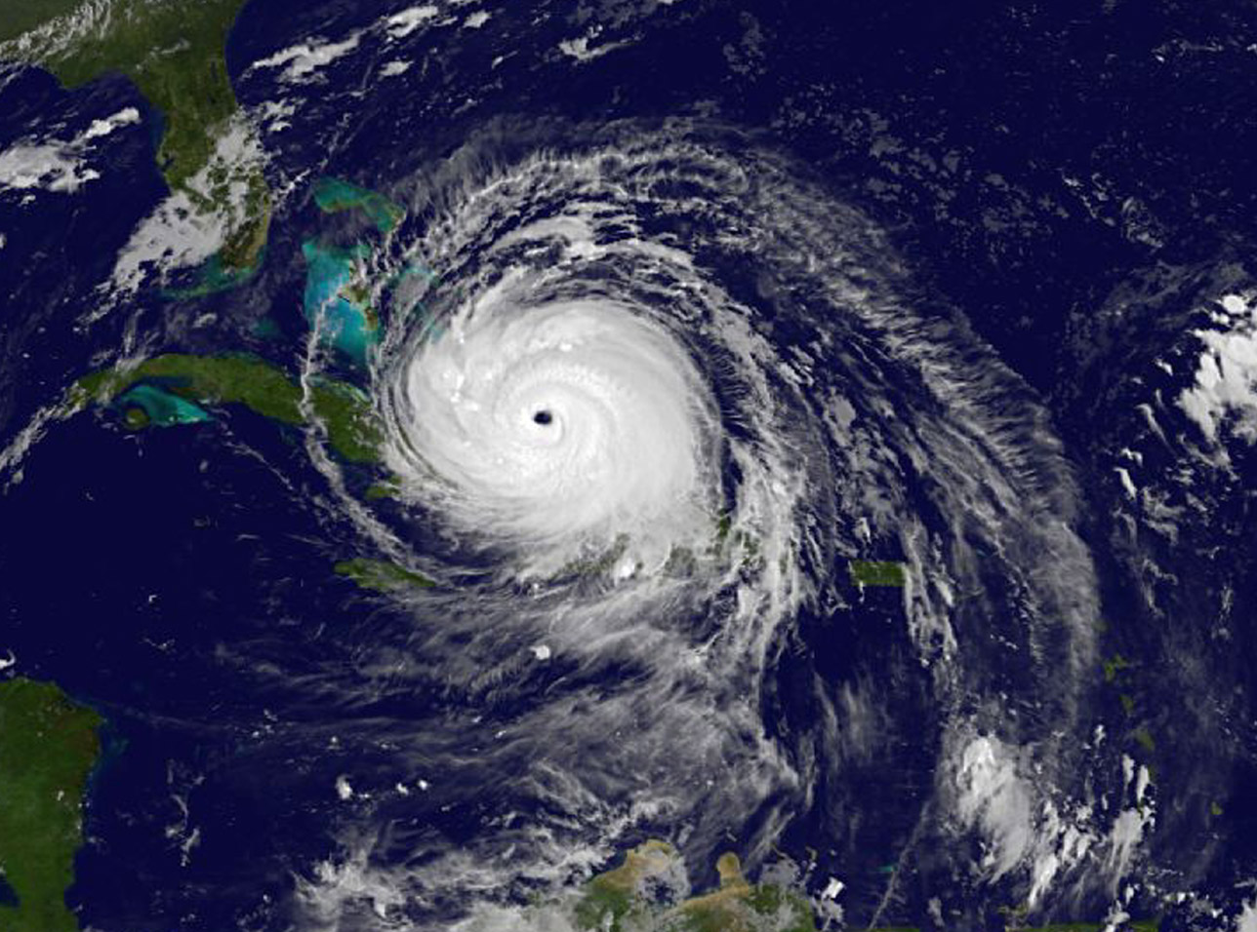
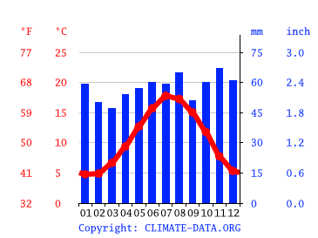
Paper 1 Section B Weather Hazards and Climate Change
Key skills
Integrated skills: (1) Use the line graphs/bar charts to explain how and why global temperature has changed since 1860.
(2) Use the GIS to track the movement of tropical cyclone, can you describe its path?
(3) Use the weather and storm surge data to calculate Saffir-Simpson magnitude. Which is the highest category of tropical storm?
(4) Use of social media source, satellite images and socio-economic data to assess impact. What features of a tropical storm can you see here?
(5) Use the climate chart to describe the rainfall trend in that place.
(6) Use and interpretation of socio-economic data
1
2
3
4
Tropical Storm Key words
Track – the path (e.g. of a tropical storm)
Frequency – the number (e.g. of tropical storms)
Distribution – where something is
Eye wall – the area immediately outside the eye of the hurricane associated with tall clouds, heavy rainfall and high winds
Diameter –a straight line passing from side to the centre of something (e.g. a tropical storm)
Magnitude – the size/extent of something (e.g tropical storm)
Storm surge – a series of large waves caused by storms.
Tropical storms form
Between 5° and 30° latitude.
Ocean temp of 27°C
Winds cause the storm to
spiral (Coriolis effect)
5
Extra Q: Using the Saffir Simpson scale to monitor the magnitude of tropical storms. Irma’s wind speed was 100mph so what category would it be in?

