Slide 1
Key words | Definition
Empiricism | The theory that all knowledge is based on experience and information gathered through the senses.
Rationalism | The theory that reason (thinking things through) rather than experience is how we gain knowledge.
Atheism | Non-belief in the existence of God or gods
Evolution | A process of gradual change that takes place over many generations, during which species of animals, plants, or insects slowly change some of their physical characteristics.
The First Cause argument | The belief that everything must have a cause, including the universe and that must be God.
The Design argument | The belief that the world is so complicated and detailed that someone must have designed it, and that must be God.
Revelation | The way in which God makes himself known to people.
Creationist | A person who believes that the universe and all life was created by God in 6 days.
Psychologist | A person who studies the human mind, emotions and behaviour.
Moral Evil | the acts of humans which are considered to be morally wrong e.g. murder
Humanist | A person who does not believe in God but does believe that life is important and special and that we should work to improve society.
Natural Evil | natural disasters e.g. earthquakes or tsunamis which humans have no control over.
Religion and Worldviews
Y8 Philosophy Knowledge Organiser
What is Philosophy?
This is about thinking. It is about finding out how and whether things make sense. It deals with questions of morality and ethics. It takes seriously the nature of reality, knowledge and existence.
Philosophers ask questions, difficult, challenging questions. Things such as:
How do I know I'm not dreaming?​
What makes me, me?​
Is there a God?​
Is there such thing as truth?​

Slide 2
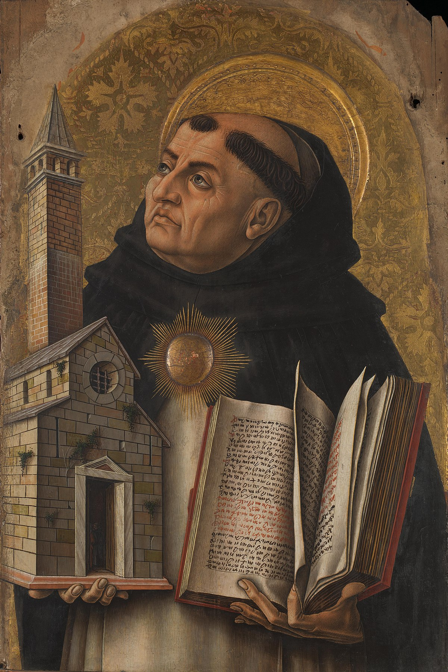
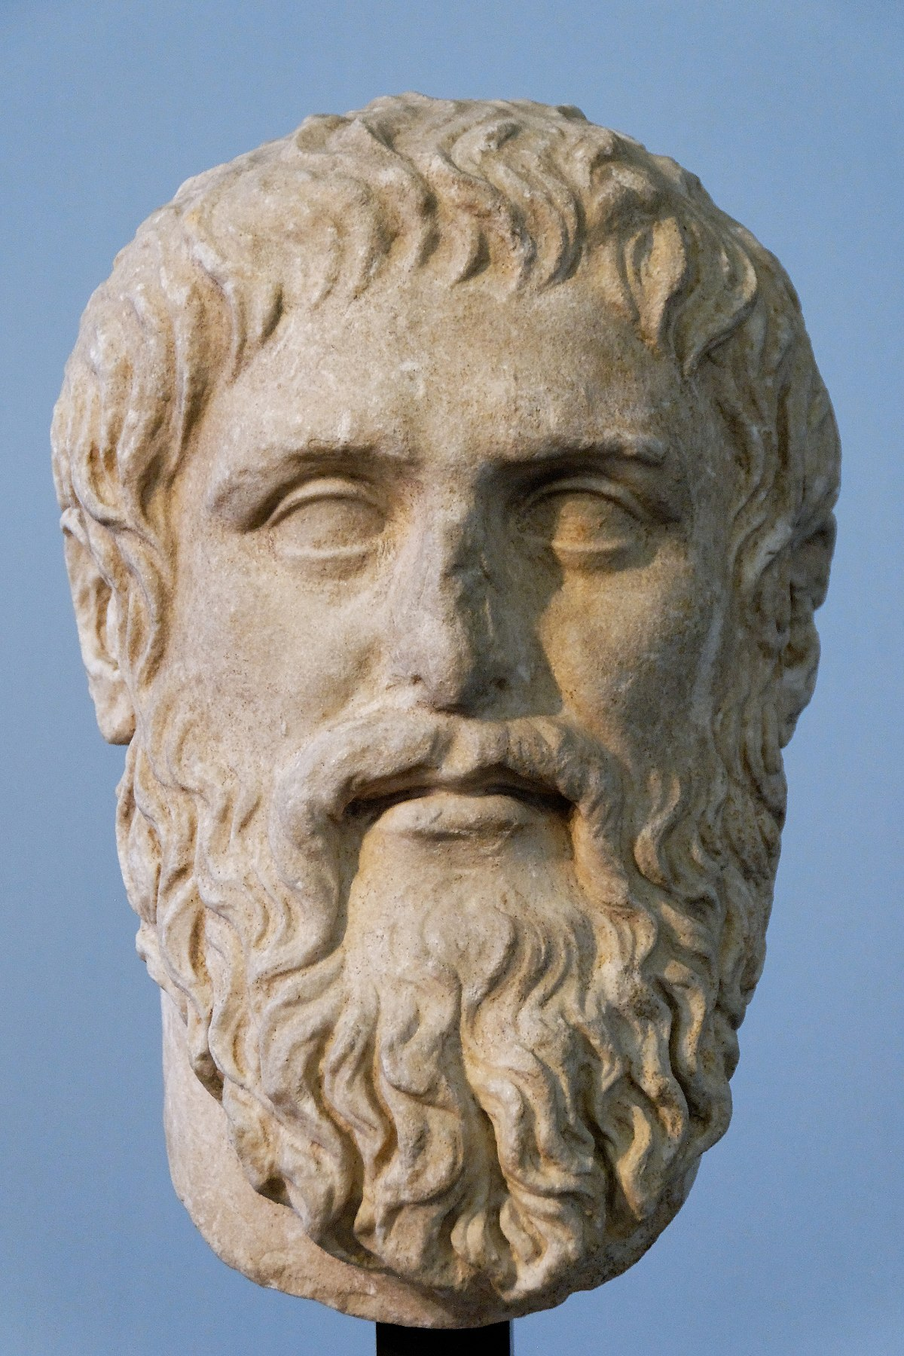
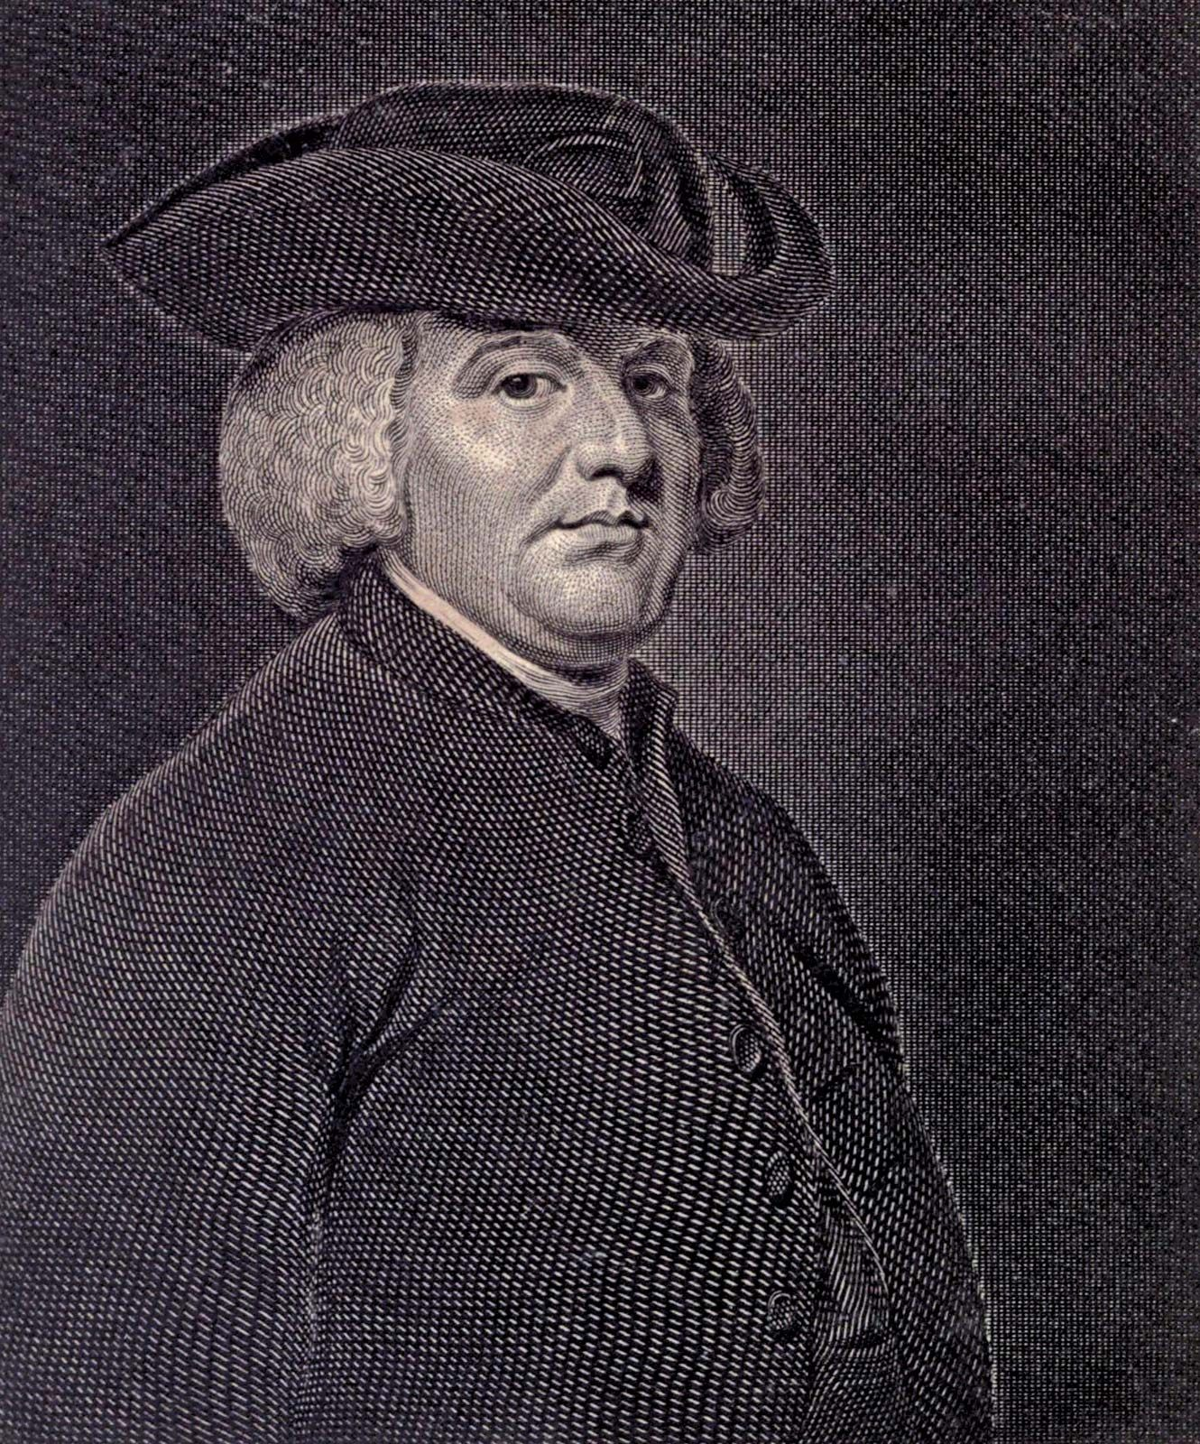
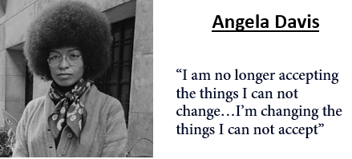
Plato 428 BCE
St. Thomas Aquinas 1225
Plato used the analogy of the cave to explain that humans easily accept their reality and that they are chained in by their limited understanding and do not question what they experience.
Humans do not look beyond their senses. But once they break out of their comfort zone and escape from the cave they will realise that things in the physical world are as flawed.
Thomas Aquinas believed that there was lots of evidence to suggest God exists, and that people are not naturally evil but we are all born good, we just sometimes make bad decisions.
Everything in the universe has a cause.
If everything in the universe has a cause, the universe itself must have a cause.
The cause of the universe must be God
William Paley 1743
Key Philosophers and Scholars
William Paley used the design argument to try and prove that there is a God. He used the 'watch analogy’. He says you wouldn't come across a watch and see how the parts are made of different substances, different weights, colours texture etc. and yet see how all the parts work together to tell the time so precisely and think that this could have happened by chance. Paley says the universe is far more complicated than a watch and so we can not think that it just happened by chance.
Rosemary Radford Reuther
Ruether was born in 1936 in Georgetown, Texas and was raised as a Catholic.
Her aim was to reform the Church in its language, rituals and theology to include a greater commitment to the well-being of women.

