Slide 1
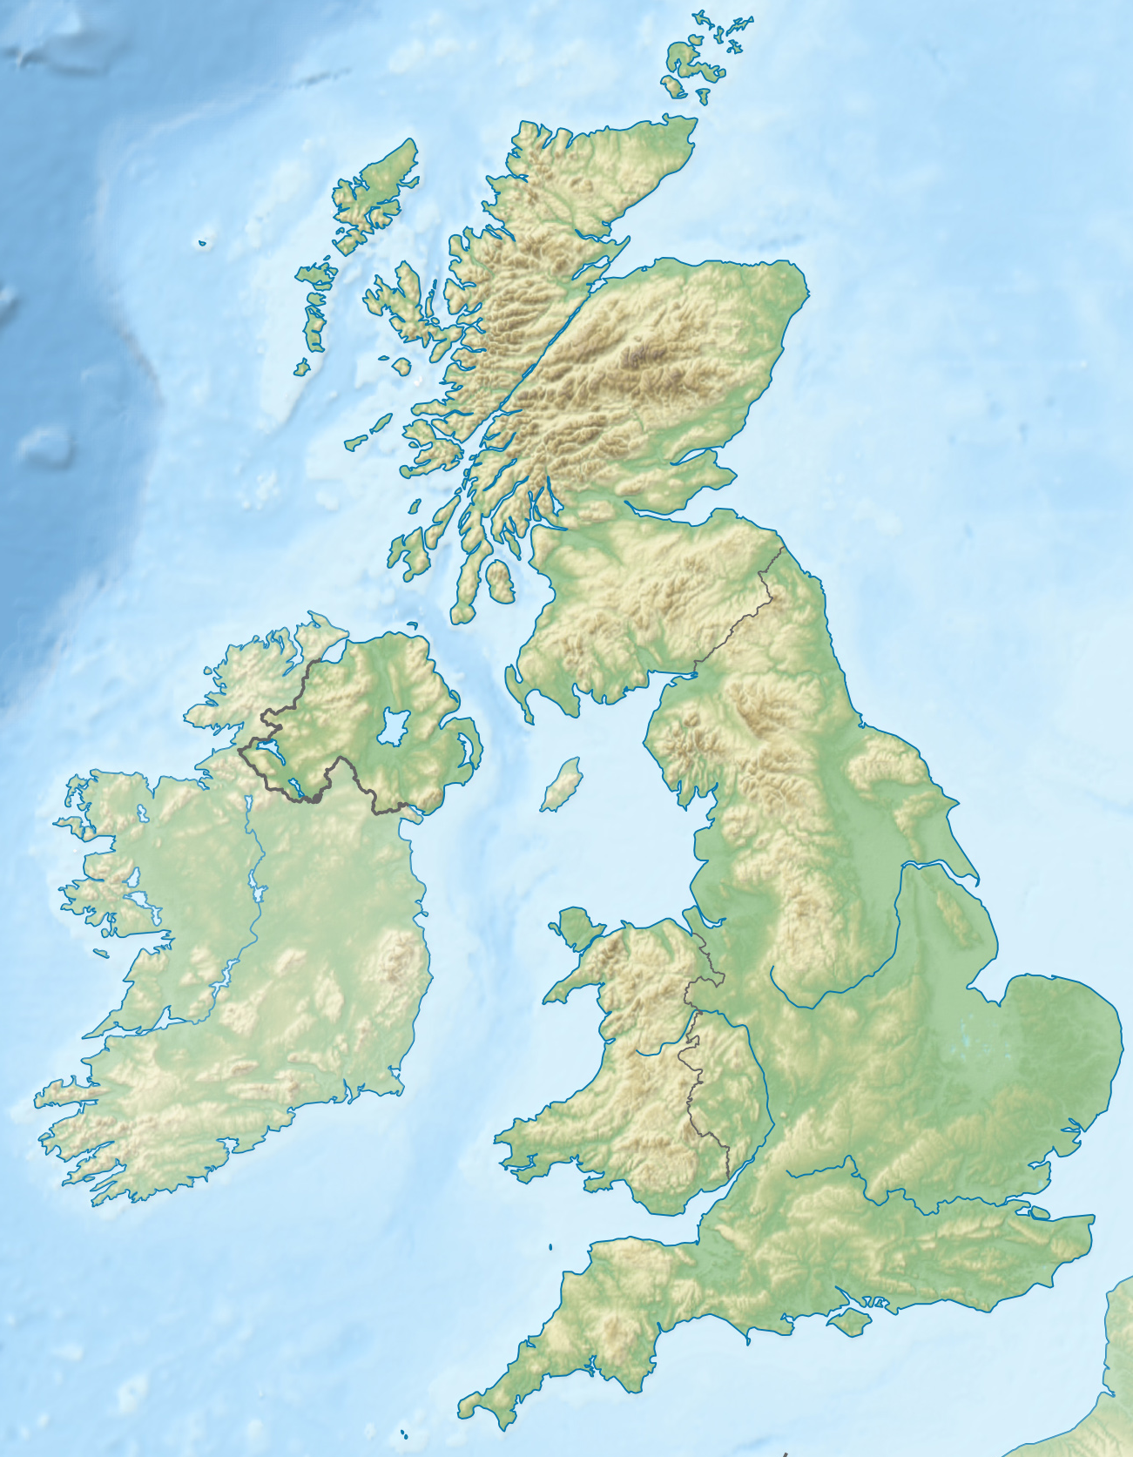
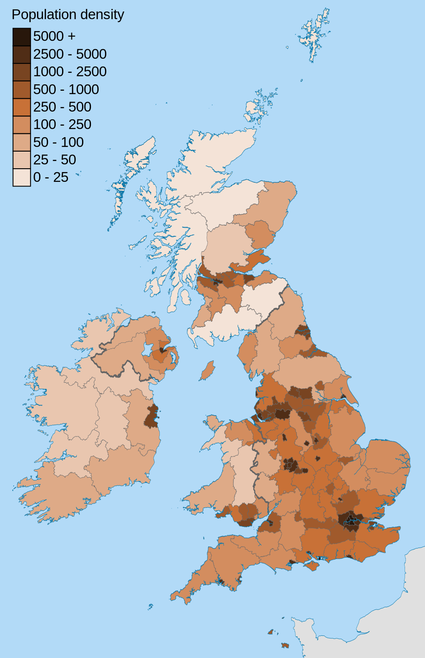
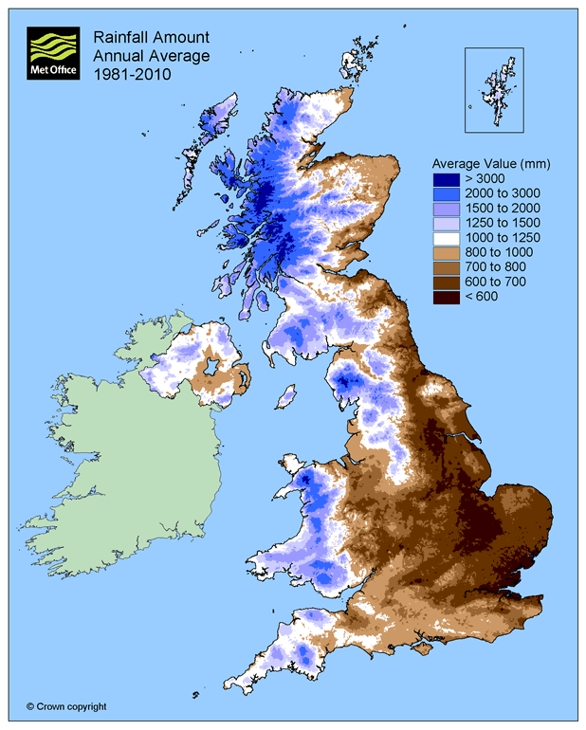
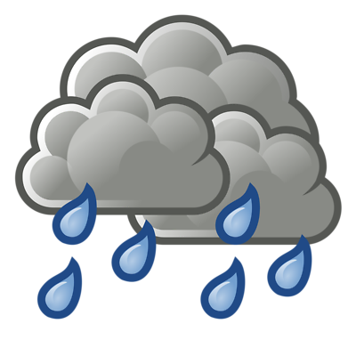
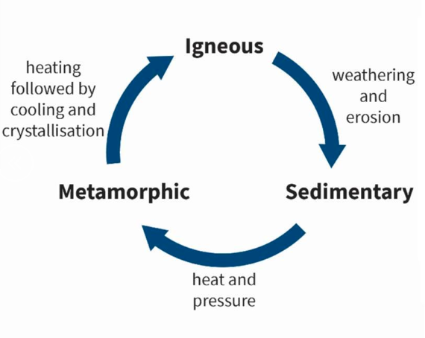
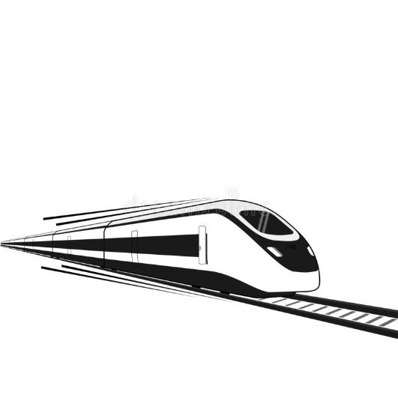
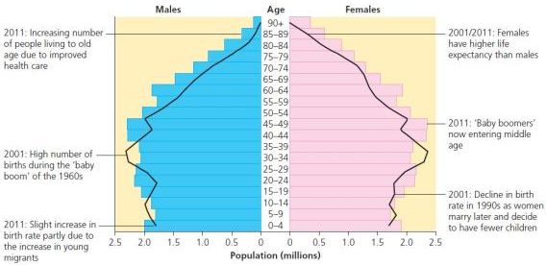
UK Physical Characteristics
Most mountains are located in the north and west, such as Wales and Scotland. These areas have few roads and settlements but beautiful scenery. – Sparsely populated. South and east of the UK is flat with a few hilly areas. These areas are suited for settlements, roads and railways – Densely populated. Rivers flow from mountainous areas down to the sea.
Main challenges facing the UK
Affordable housing people want to build on greenfield sites. Other people think it is better to build on brownfield sites. Brownfield sites are typically located in urban areas because they've previously been built upon. On the other hand, greenfield sites have never been built on and can be found in the countryside or rural areas. |  | The North South Divide In the North of England people have a lower income, live shorter lives and have a poorer education. The North West region has average salaries of £35, 367 London has the highest earnings at £44,184
Deindustrialisation and changes to the economy. In the pre-industrial times most people worked in the primary sector – which is the extraction of raw materials. During the industrial revolution and until around 1970 most people worked in the secondary sector in the UK manufacturing goods like steel. During the 1970s, the number of jobs in the secondary sector declined because goods can be produced quicker (mechanisation) and cheaper by machines or in less developed countries where wages are lower Today, most people work in the tertiary sector which is known as the service sector this includes jobs like shop keepers, doctors, taxi drivers. Tertiary sector jobs are well paid. More and more people are working in the quatenary sector – this is the sector of the economy that focusses on research and development e.g. engineering, vaccine development.
UK Population Distribution
Low
Much of Northern Scotland is sparse due to a mountainous landscape, igneous and metamorphic geology and difficult climate.
High
Rest of the UK because of the gentle hills, moderate climate and good transport routes.
Very High
Population is concentrated around the South East of England, in cities such as London, due to attractions of employment, shops and entertainment.
UK Rainfall Patterns
Highest rainfall is in the north and west where average rainfall is 2500mm.
Lowest rainfall is in the south and east with average rainfall of 500 – 625mm.
Factors affecting population density
Moderate climate. | Remote and poor communications. | Opportunities for work
A presence of raw materials. | Steep and mountainous. | Fertile and suitable for farming.
Poor quality of soil. | Plentiful supplies of water. | Flat land for farming.
 | Local population
 | Brinsworth | Sheffield | UK
Total | 9,527 | 584,028 | 66970000
Most common age group | 16-64 | 16-64 | 16-64
Lots of people of working age means that the economy can grow. However, in the future, as less babies are being born, there will be fewer people working and those who are currently of working age will grow old, retire and rely on working age people to support them financially or socially.
Year 7 Topic 4 - UK Uncovered
Population in the UK
The UK population is 65 million and still rising. It is predicted to reach 70 million by 2030.
Reasons for growth | Future of growth
Natural increase – the difference between deaths and births. Net migration – the difference between immigration to the UK and emigration from the UK. Life expectancy – the average age someone will live up to. | The UK’s population pyramid shows that the country’s birth rate is fairly low and death rate is also low meaning there are more elderly people. Population pyramids are useful to help plan for the future.
These rocks can all be found in the UK.
They transform into each other through different processes.
Solving the North South Divide
A high speed train from London to the North of England. It will reduce journey time from London to northern cities which could increase business. More training for jobs. Northern Powerhouse is a government strategy intended to boost training e.g., with National Colleges More investment in business - The NP11 is a group of people who aim to increase investment in business in the North. Regional mayors who have more control in the area. For example, they could decide how money is spent in the area.
KEY WORDS:
relief, igneous, sedimentary, metamorphic, densely and sparsely populated, birth rate, greenfield site, industry, economic sectors (primary, secondary, tertiary and quaternary), deindustrialisation, north south divide, infrastructure, urbanisation/urban, rural, migrant, international migration, emigration, immigration, economic migrant, refugee, average, mean, death rate, brownfield site, salaries, earnings, two speed economy, levelling up, population distribution, deposition, contour, tectonics, mechanisation, globalisation

