Slide 1
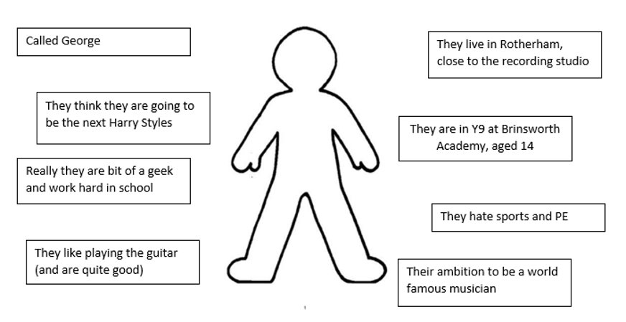
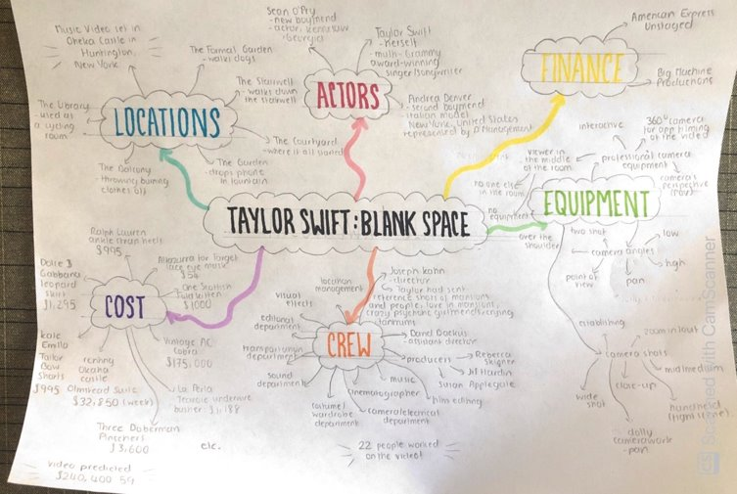
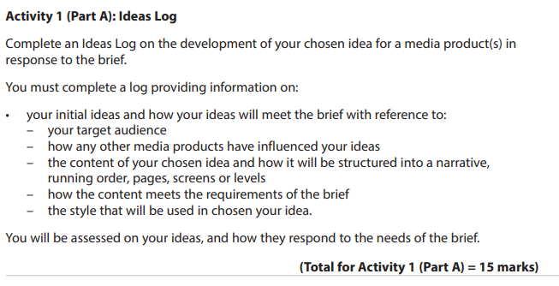
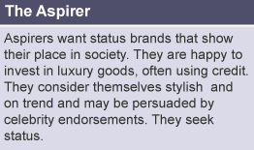
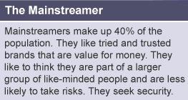
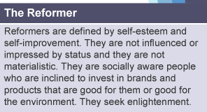
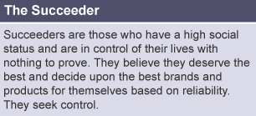
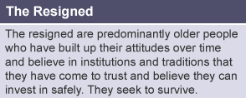
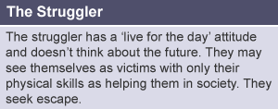
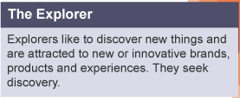
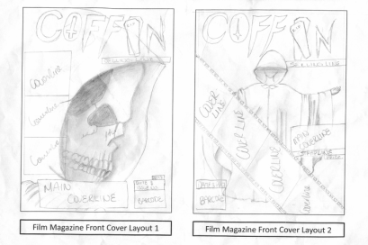
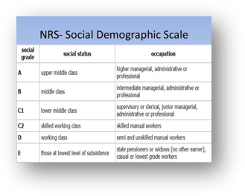
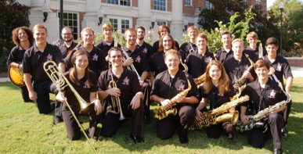
Knowledge Organiser: CMP Component 3 – Part 1 Ideas log and Planning Material
Modes of Address:
Direct mode of address - The model looks directly at the audience, or the writing speaks to ‘you’.
Indirect mode of address - The model looks away, or the writing refers to ‘people’ or ‘the public’.
Formal mode of address - Using formal phrasing and terminology.
Informal mode of address - Using more conversational language and slang.
Friendly mode of address - The tone is optimistic and comforting.
Hostile mode of address - The text challenges or insults the reader.
Humorous mode of address - The writer/presenter is trying to make you laugh. The tone could be sarcastic or ironic.
Serious mode of address - The writer/presenter wants you to take their point seriously. The tone would be sincere
What is an ideas log?
is exactly what it sound like – it is a LOG of your IDEAS which describes the media product you will create.
Pen Portrait Example:
Mind Map Example:
Key terms – write the definitions:
Typography:
Headlines:
Straplines:
Pull Quotes:
Cover Lines:
Task:
Draw a Flat Plan and a mock up for the front cover of a charity magazine (choose an existing charity)
Target Audience
Primary - the core group of people that you try to reach and are most likely to purchase your products or services.
Secondary - the group of people who are the second most likely to purchase your products and services.
Psychometrics
Mock up Example (Distinction should have colour):
Target Audience
Socio-economic groupings
Age (e.g. 13 to 19)
Gender (e.g. Male/Female)
Ethnicity
Psychometric Groups
Ethnicity
A group of people that have a common background or culture, whether through hobbies/interests, job, race, religion or language

