Slide 1
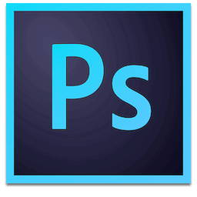
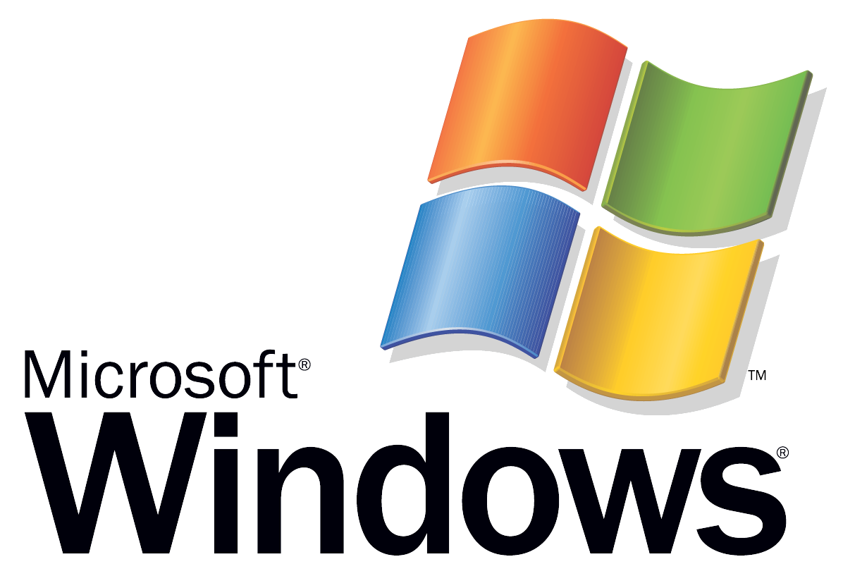
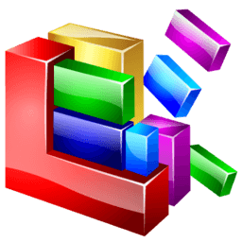
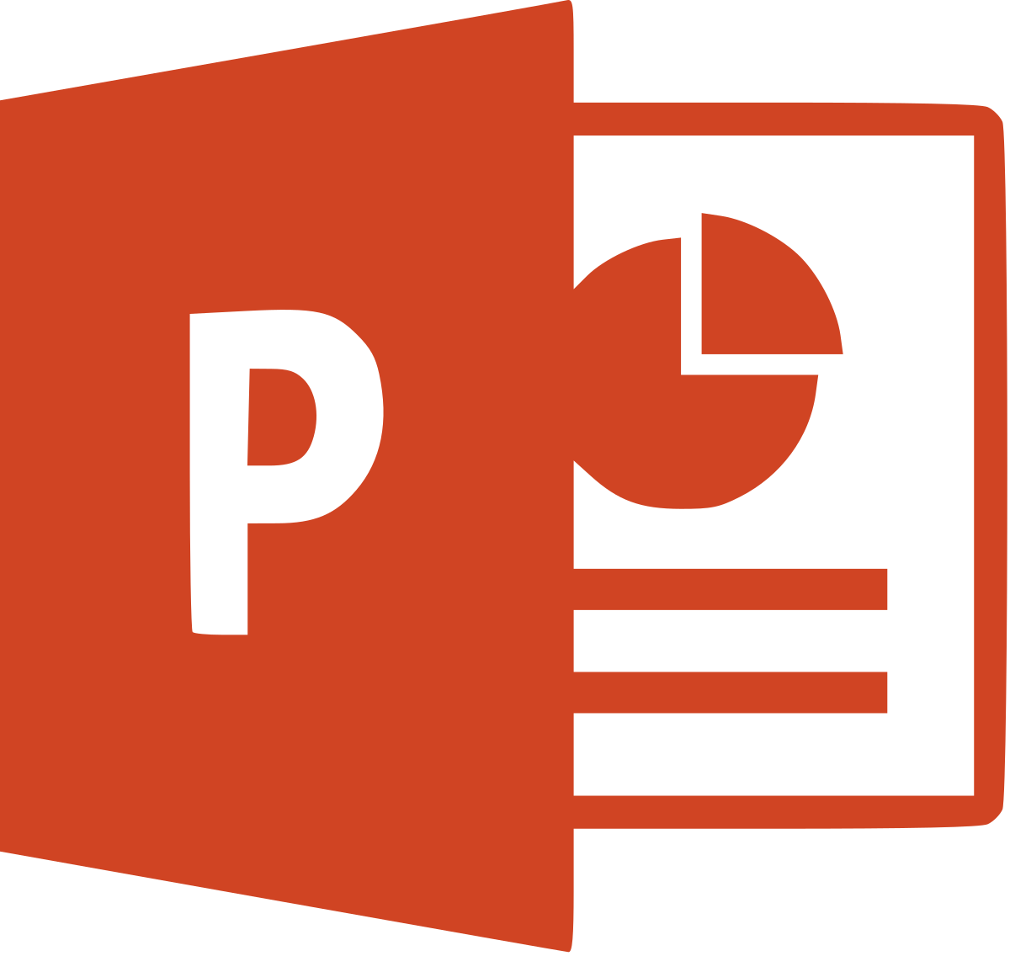
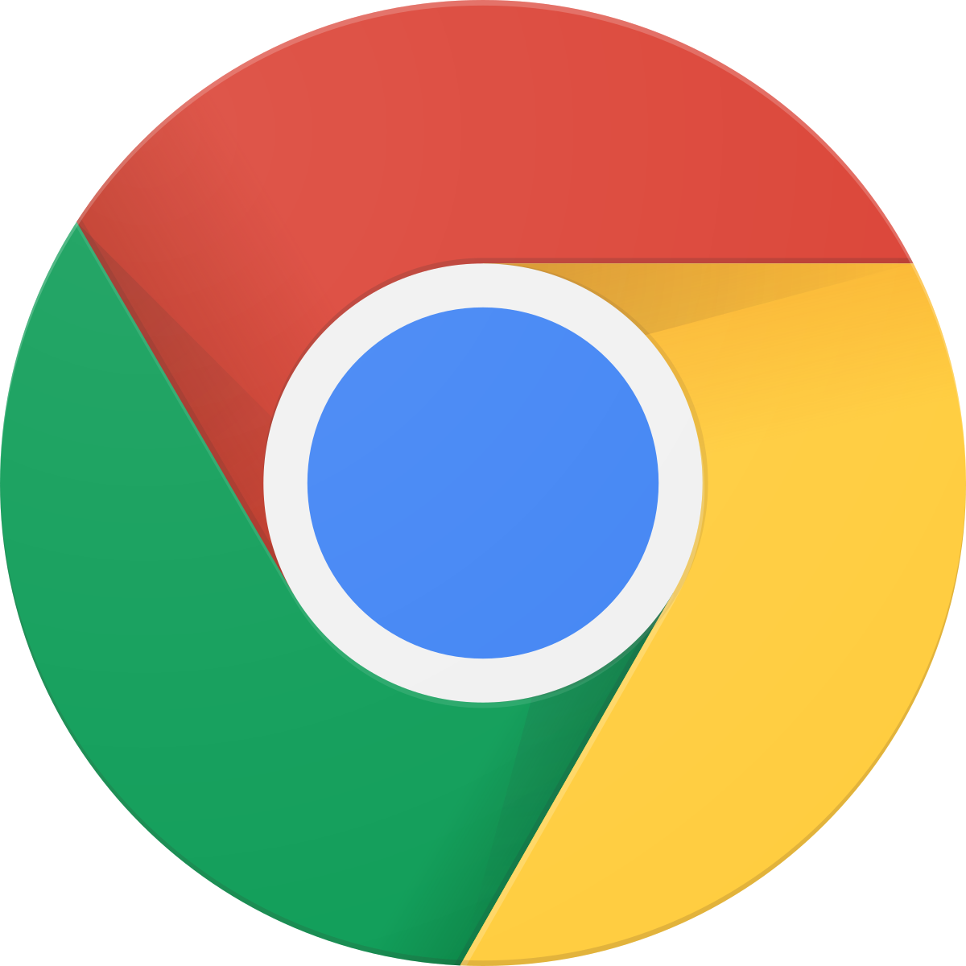
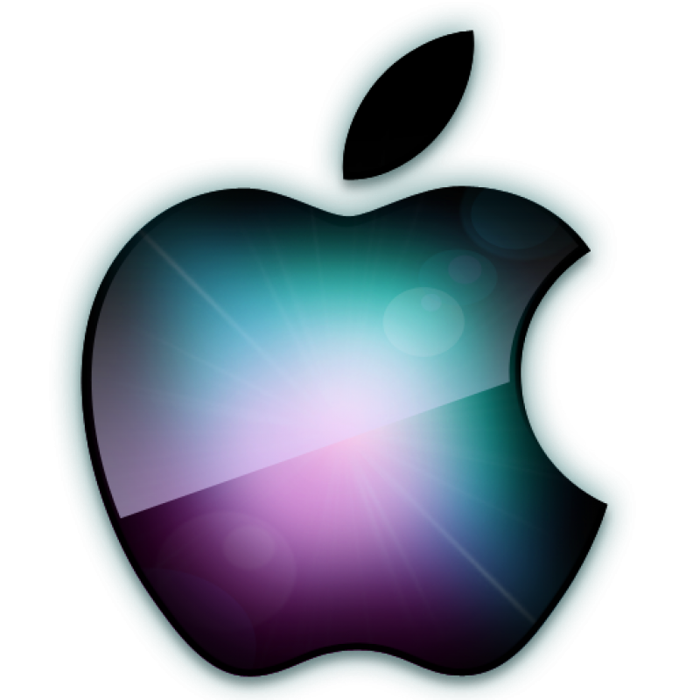
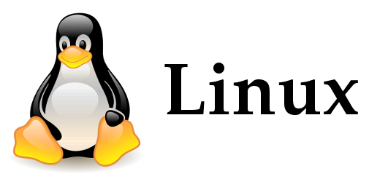
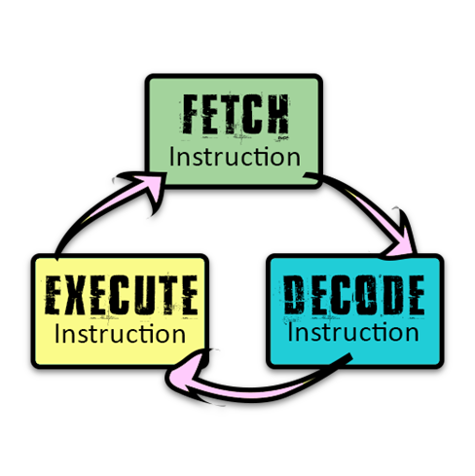
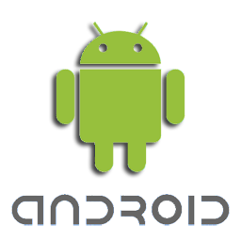
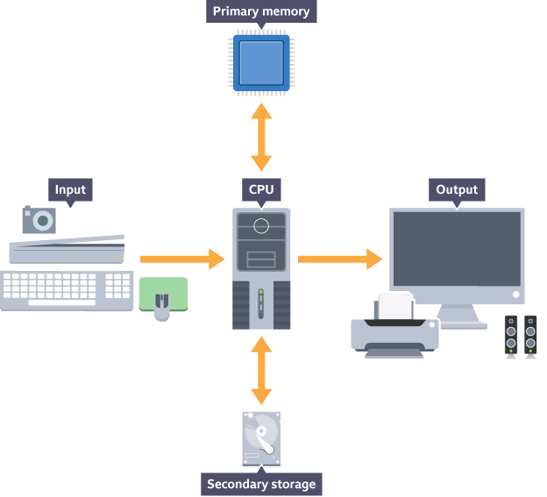
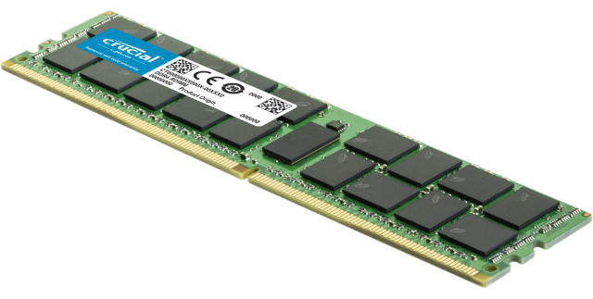
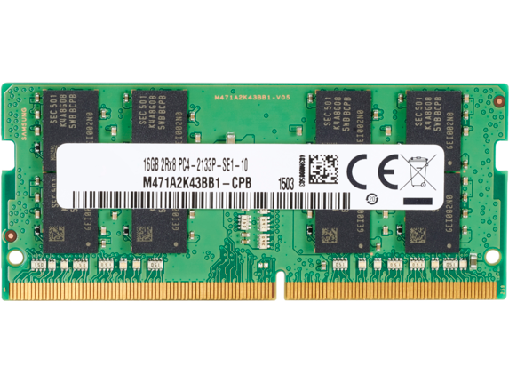
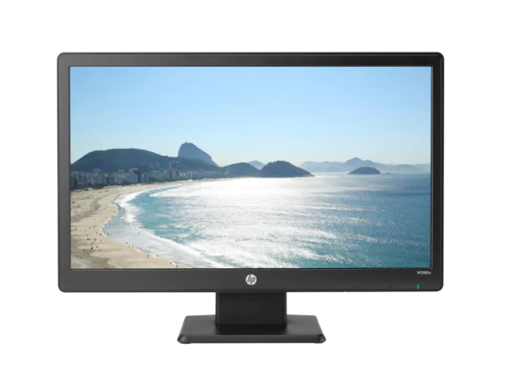
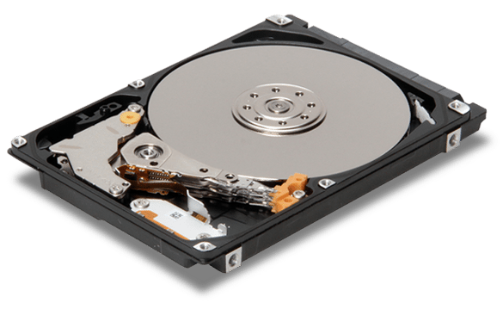
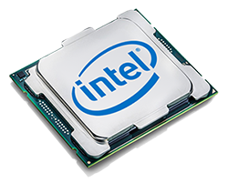
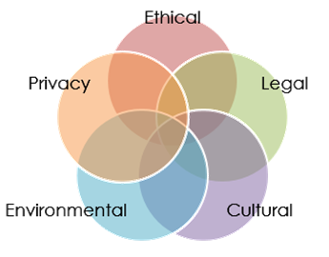
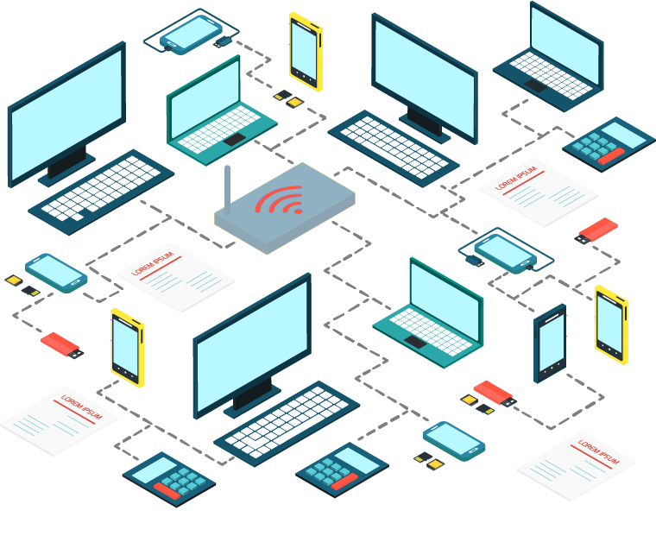
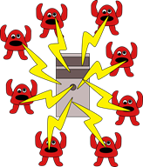
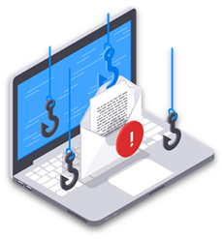
Component | Description
CPU | Processes instructions and data. Controls other components and coordinates activity in the computer system.
RAM | Primary storage that temporarily stores applications and data that are currently in use by the computer system. This is considered Volatile
ROM | Primary storage that stores the BIOS and boot up instructions. It is loaded with its own battery and does not rely on the power of the system.
Hard Drive | Stores applications and data permanently. Applications and data are copied from here into RAM when they are being used. Can be HSS or SSD.
Keyboard/ Mouse | Input devices used to give instructions or orders to a computer system.
Monitor/ Speaker | Output devices used to give an output from the computer.
SOFTWARE
Component 1 (50%)
Computer Systems
APPLICATION SOFTWARE
SYSTEMS SOFTWARE
1.1 - System Architecture
OPERATING SYSTEM
UTILITY SOFTWARE
1.2 - Memory & Storage
1.3 - Networks/Connections/Protocols
hardware
1.4 - Network Security
Without system software, the user has no way of controlling the hardware!
1.5 - Systems Software
Benefits of Networks
Sharing files / data / information
Sharing an internet connection
Sharing peripherals
Centralised administration
1.6 - Ethical/Cultural/Enviro
What is morally right and morally wrong.
Malicious Software – Malware
How technology affects the privacy of our data and of our identity.
Threats and Attacks
Brute Force Attack
Denial of Service (DOS)
Phishing
Malware is malicious software that is installed without the knowledge or consent of the user. | Virus, worm, trojan, spyware, rootkit and ransomware are examples of malware | It is usually relatively easy to detect as it will perform a malicious action that will impact the user
What is right and wrong in the eyes of the law.
How technology impacts the environment and how environmental issues affect technological progress.
How things like ethnic groups, countries and religions affect and are affected by technology

Slide 2
Component 2 (50%)
Computational Thinking, algorithms & Programming
2.1 - Algorithms
2.2 - Programming Fundamentals
2.3 - Robust Programming
2.4 - Boolean Logic
2.5 - Languages & IDE’s

