Slide 1
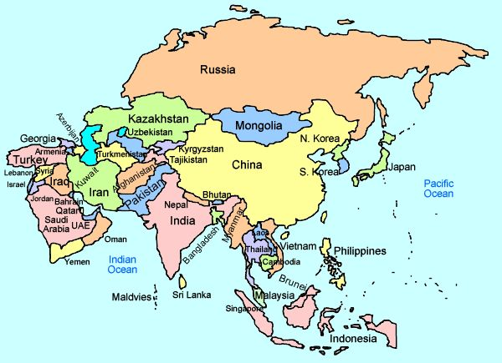
Year 8 Topic 1 – Amazing Asia | Asia is a continent with 48 countries in it. The world’s continents are; Asia, Africa, Europe, Antarctica, North America, South America. |  | India has a monsoon climate Monsoons are caused by temperature differences in the air over land and sea. They blow from colder to warmer areas. In a monsoon region in summer the land and the air above it become very hot. The nearby sea and the air above it are cooler. Hot air is lighter than cold air, so the hot air over the land rises. The cooler sea air then rushes in to replace the air that has risen. This is the summer monsoon. The monsoon winds are heavy with moisture from water that evaporated from the sea. The moisture is dropped over the land in the form of heavy rains. Sometimes this process fails causing shortages of food.
What makes China a superpower? Military, world’s factory, fastest growing GDPs, nuclear power
 | The BRICS: Brazil, Russia, India and China are predicted to be the world’s superpowers in the future. 3 of them are in Asia which shows how important Asia is.
What makes India a superpower? Fastest growing population, nuclear power, military.
What makes Russia a superpower? It has access to lots of natural resources like gas which it exports across the world 39% of gas from the country to Europe last year. It also has a huge military.
Human Geography of China Fast growing population Migration from the west to the east Fast growing economy Produces the world’s goods. | TNCs Many transnational companies locate in Asian countries because they can pay less tax, lower wages and because the population is so big, a huge workforce. In China, the Apple factory has provided higher paid jobs and education for people who would usually work in the west, farming the land and being paid very little |  | Key words
 |  |  | Wages – the money made from working Labour – the term given to work Tax – money paid to the government when you earn a wage Emerging – a country that is becoming more developed Infrastructure – things that are built that help a place develop e.g. schools Sparsely - not a lot of (people) Trade – the buying and selling of goods and services. | Super power - ‘A superpower is a nation with the ability to project its influence anyway in the world and be a dominant global force GDP – the money made within a country Monsoon – a rainy period Region – an area Evaporated – when liquid is turned into a gas Inequality – unevenness Landlocked – when a country is surrounded by others.
The environmental impact of China China uses lots of coal – it has the most supplies in the world. It burns that coal to create energy to power factories. 28% of the world’s carbon dioxide emissions are made in China. | The problem with TNCs Many TNCs like Apple, exploit their workforce by paying low wages or by allowing poor working conditions e.g. Apple in Shenzen China. | India suffers from inequality Coastal locations such as Mumbai have benefitted from being a trade route with the rest of the world –this means that they are richer. Areas like Rajasthan are poorer than the South and West of India due to the failures of monsoons affecting crops. The north and east of India are landlocked, therefore cannot directly trade internationally.
 | KEY words - superpower, trans-national corporation (TNC), monsoon, industrialising, flood, flood hydrograph, mountain biome, inequality, conflict, prisoner of geography, qualitative data, labour, wage, emerging, air pollution, sustainable, non renewable, renewable, energy mix, influence, colonialism, democracy, communist, monarchy, social, economic, environmental, high relief, low relief, diverse, sparsely, densely, BRICs, former super power, emerging superpower, resources, governent, military, development, GDP, physical, migration, climate, density, distribution, relief, trade, deforestation, biodiversity, tundra, taiga, temperate

