Slide 1
Y9 Economics Knowledge Organiser
Needs, wants, goods and services
Opportunity cost
Needs are….. Essential to our daily life.
Wants are….. Things we could survive without.
Choice- Making a decision normally involves a trade-off.
Trade-offs- A trade-off arises where having more of one thing potentially results in having less of another.
Opportunity cost is the cost of missing out on the next best alternative. In other words, opportunity cost represents the benefits that could have been gained by taking a different decision.
What to produce? What should the economy produce in order to satisfy human wants. Examples include phones, guitars, laptops.
How to produce? Producing goods using the least amount of materials to make the most profit.
For whom to produce? Deciding a target market, e.g. targeting people with a high income or to target the people with a low income. E.g. Luxury car companies such as Bentley or Bugatti would target very wealthy consumers with a high income, whereas McDonalds would be able to market to children as they are not targeting wealthy people.
Good are tangible things that can be consumed
Service is a transaction in which no physical goods are transferred from the seller to the buyer.
Scarcity is…
The equipment used to provide the good or service
Limited quantities of resources but, unlimited wants and needs
C
Economic sectors
The skills of the people running the business to identify business opportunities
E
Factors of production
Factor market and product markets
L
The land/site which the business is located on & other natural resources
A factor market is a market where factors of production are bought and sold, such as the labour market, the physical capital market, the market for raw materials, and the market for management or entrepreneurial resources.
L
The skills and numbers of employees
The product market is the marketplace in which final goods or services are offered for purchase by consumers, businesses, and the public sector.

Slide 2
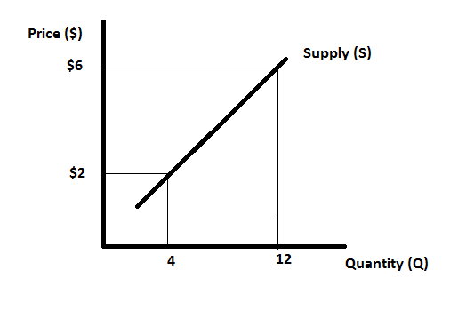
Y9 Economics Knowledge Organiser
Specialisation and division of labour
L11 What is demand?
Division of labour
When production of a good or service is split into a number of smaller tasks and employees then specialise in completing each of these tasks with the intention of increasing productivity.
Specialisation
When a person, business or country focuses on the production of a limited number of products or focuses on a small number of tasks in order to gain greater efficiency.
Demand is the quantity of a good or service that consumers are willing and able to buy at a given price in a given time period.
Effective demand – demand supported by the ability to pay for a good or service (willing and able), not just something you want.
Price
a complementary good or complement is a good where a good's demand is increased when the price of another good is decreased. Conversely, the demand for a good is decreased when the price of another good is increased
Substitute goods are two goods that could be used for the same purpose. If the price of one good increases, then demand for the substitute is likely to rise. Therefore, substitutes have a positive cross elasticity of demand.
Benefits of division of labour
1. Increase in Productivity:
2. The Right person in the Right Place:
3. Dexterity and Skill:
4. Saving in Time:
5. Economy in the Use of Tools:
6. Use of Machinery Encouraged:
7. Cheaper Goods:
Quantity
What is supply?
Supply is the quantity of a product that a producer is willing and able to supply onto the market at a given price in a given time period.
This is familiar???
The supply curve is upward sloping – here a supplier is only willing and able to supply 4 goods at $2 but, if the price rises to $6, they would be willing to supply 12.
Specialisation happens at all levels:
The specialisation of tasks within extended families in many of the world’s poorest countries
Within businesses and organisations
In a country
In a region of a country

