Slide 1
What is an Algorithm?
An Algorithm is a series of steps to solve a problem.
Computer Scientists turn Algorithms into programs – a series of steps for computers to follow in order to solve a problem.

Slide 2
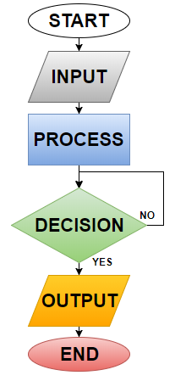
Flow Chart Symbols
L1 - T1
All flowcharts begin with the START symbol. This shape is called a Terminator.
INPUTS indicate external entry of data e.g. “entering a username/password during a login”
PROCESSES indicate a task carried out by the program like performing a calculation “Result = a + b”
The DECISION symbol checks a condition before carrying on. Two paths must be identified here based upon whether the condition is met or not e.g. “Is it raining? Yes or No!”
OUTPUTS indicate the delivery of data from the program like displaying a calculation result on the screen or writing data to a file.
All flowcharts end with the END symbol. This shape is also called a Terminator.

Slide 3
What does Pseudocode mean?
Pseudocode means “fake code”. It looks like code, but it is written so that humans understand it, rather than computers.
Programmers use Pseudocode to plan their algorithms. It can be understood by any programmer.
Pseudocode will not run in Python or any other programming language, but it can be used as a plan to start writing real code.

Slide 4
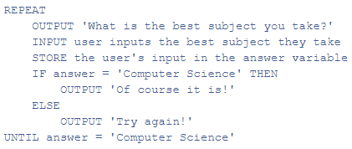
Pseudocode
L2 - T1
“Pseudocode looks like code”
What does this mean? What does code look like?! How is it different to a normal sentence or paragraph?
Pseudocode includes the following things that make it look like code:
Indentation
Command words
Loops
IF statements

Slide 5
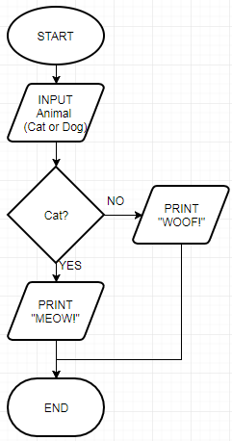
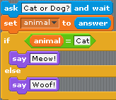
Flowchart → Pseudocode → Actual Code!

Slide 6
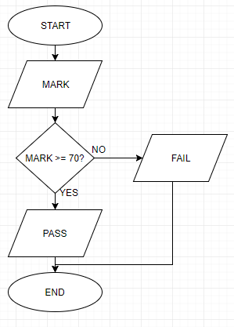
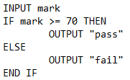
Task 1 - Grading System - SOLUTION

Slide 7
Iteration
Iteration is the process of repeating sections of a program to achieve a particular target or goal.
Also known as a Loop
There are 2 main categories:
Count controlled loop
Condition controlled loop

Slide 8
Iteration - Count Controlled Loops
Count controlled loops are usually implemented with a FOR loop.
This will loop a predetermined number of times, for example:
FOR every item in a list
FOR every number in a range of numbers
FOR each player in the game

Slide 9
Iteration - Condition Controlled Loops
Condition controlled loops are usually implemented with a WHILE loop or REPEAT UNTIL loop.
These will loop as long as a certain condition is met, for example:
Move forward until an obstacle is met
Keep flying until you run out of fuel
Spawn enemies until score is greater than 10

Slide 10
sorting Algorithms - BUBBLE
The Bubble sort repeatedly works through a data set, on each iteration it:
Compares each adjacent set of items
Swaps them if they are in the wrong order
On each pass, the largest item bubbles up to the top! The process is repeated until the data set is sorted.

Slide 11
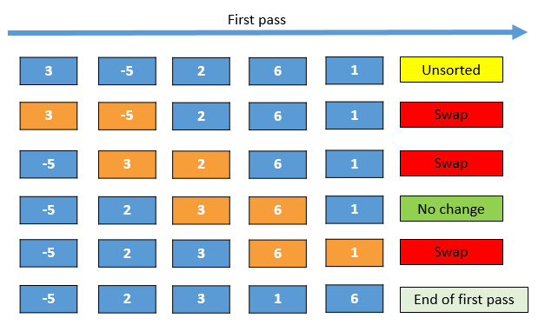
sorting Algorithms - BUBBLE
A bubble sort algorithm goes through a list of data a number of times, comparing two items that are side by side to see which is out of order.

Slide 12
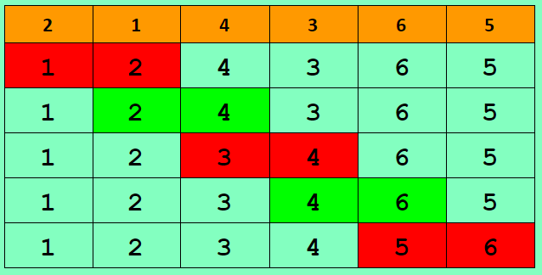
Bubble Sort - EXAMPLE
The list 2,1,4,3,6,5 can be sorted in 1 iteration.
There will be 5 comparisons, and 3 swaps.
SWAP
NO SWAP
SWAP
NO SWAP
SWAP

Slide 13
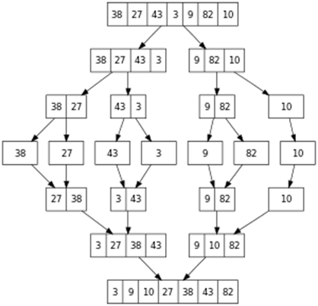
Merge Sort
The Merge Sort Algorithm is an example of a Divide-and-Conquer algorithm and takes advantage of two facts:
Small lists are easy to sort
It is easier to merge two ordered list than two unordered lists

Slide 14
Merge Sort

Slide 15
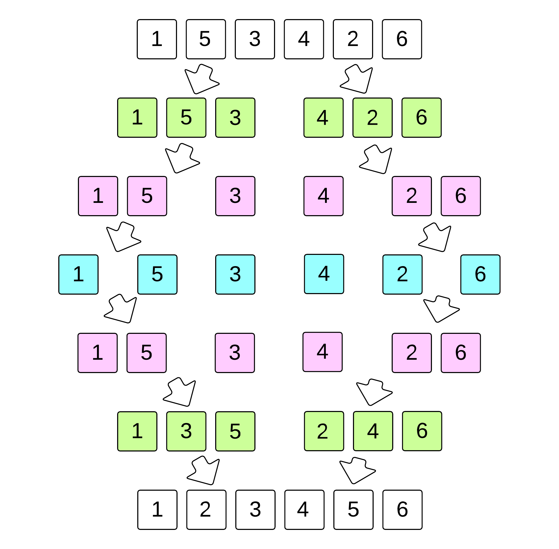
Merge Sort
The Merge sort is split into 2 main steps:
Split / Divide
Merge

Slide 16
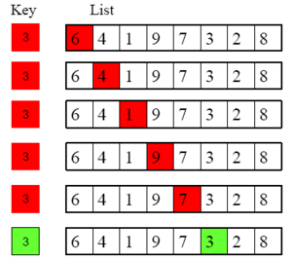
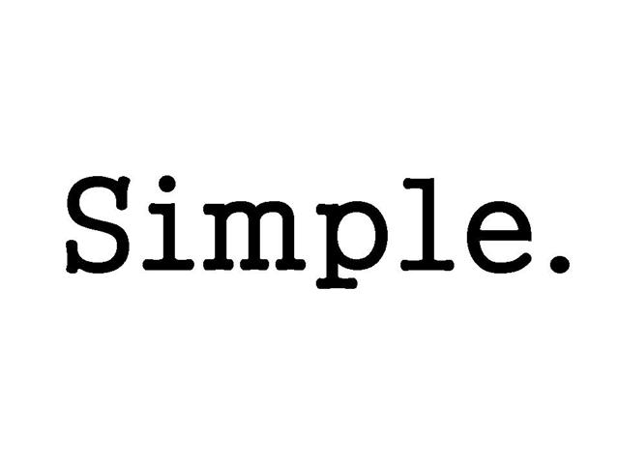
Linear search
Linear search is the simplest searching algorithm
It simply works through the list 1 item a time.
It checks each item to see if it is the one we are looking for.
If it is, is stops and returns the position, otherwise it moves on to the next item until it reaches the end of the list

Slide 17
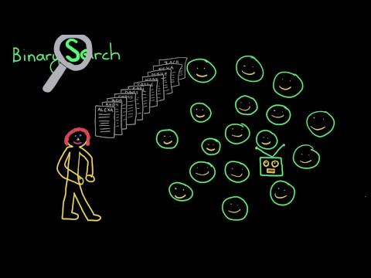
Binary Search

Slide 18
Binary Search
Binary search repeatedly discards half the list, making it very efficient with big lists
Even if we double the size of the list, the algorithm only has to do 1 extra check

