Slide 1
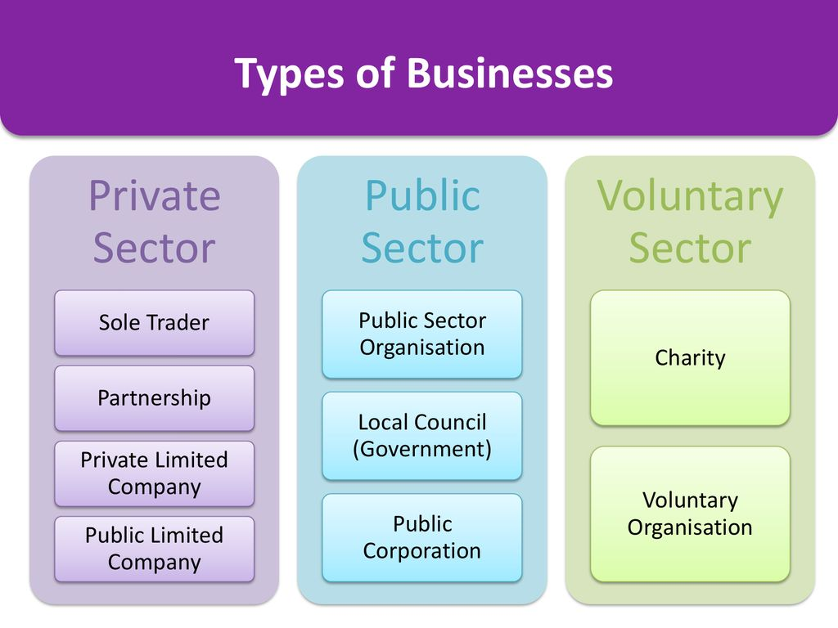
Learning outcome A: Demonstrate an understanding of the UK travel and tourism industry
A1: Major Components of UK Travel and Tourism Industry
Accommodation Providers
Catered: Offer meal options; Self-catered: Provide cooking facilities; Room only: No meals or cooking facilities
Key Products/Services: Various property types, amenities (reception, food, entertainment), safety/security, sustainability efforts
Transport Operators
Road, Rail, Sea, Air: Each mode offering different services and experiences
Key Products/Services: Transport modes, passenger services (luggage, classes, extras), safety measures, sustainability initiatives
Visitor Attractions
Natural, Purpose-built, Heritage: Each category offering unique experiences
Key Products/Services: Entertainment, preservation, customer service, safety, sustainability practices
Tour Operators
Domestic, Inbound, Outbound; Specialist, Mass market: Serve different markets with tailored packages
Key Products/Services: Package holidays, customer-tailored services, safety measures, enhancing visitor experience
Travel Agents
Business, Retail, Online agencies: Varying platforms for selling travel products/services
Key Products/Services: Sale of diverse travel services, ancillary offerings (car hire, insurance), prioritizing customer service
Tourism Promotion
Visitor Information, Tourism Agencies: Providing information and marketing services
Key Products/Services: Informational materials, marketing campaigns, training, customer service initiatives
Ancillary Services
Specialized, Additional services: Offering supplementary services beyond core travel
Key Products/Services: Ticket sales, insurance, car rentals, customer service support
A2: Ownership and Aims
Private, Public, Voluntary sectors: Differ in ownership structure and goals
Aims: Profit, Public service, Social impact (depending on sector)
Common Aims
Financial: Profit generation, sales increase, cost control
Strategic: Sustainability, community contributions, service excellence
Collaboration
Interrelationships, Interdependencies: Working together for mutual benefit
Methods: Joint activities, resource sharing, partnerships for efficiency and growth
A3: Role of Consumer Technology in Travel/Tourism
Types of Consumer Tech
Websites, Apps, AI, VR, AR, Wearable devices: Various tech enhancing user experiences
Reasons for Offering: Attracting wider audience, boosting efficiency, ensuring customer satisfaction, maintaining competitiveness
Advantages/Disadvantages
Advantages: Convenience, Accessibility, Cost-saving, Enhanced experiences
Disadvantages: Device reliability, Security concerns, Reduced personal interaction

Slide 2
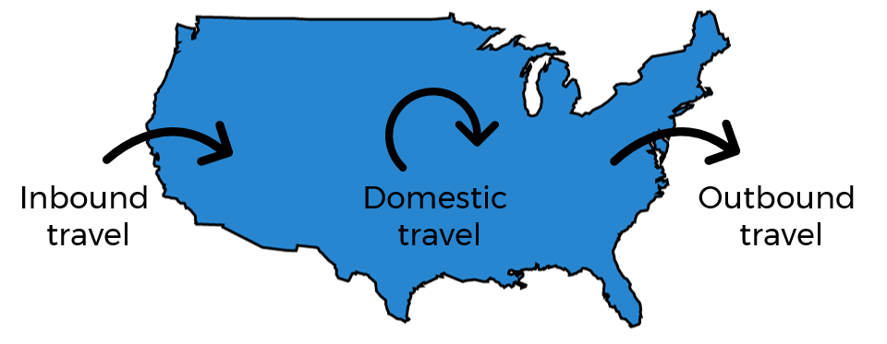
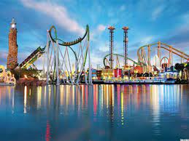
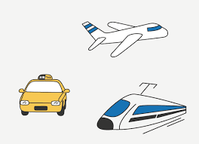
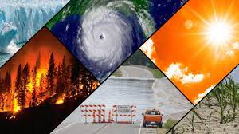
B1: Visitor Destinations
Types of Destinations
Cities: Urban centers with diverse attractions, cultural hubs, and various amenities
Cultural/Historical Towns: Places rich in history, cultural significance, and heritage sites
Coastal Resorts: Destinations along coastlines offering beach activities and seaside leisure
Countryside Areas: Rural settings with natural landscapes, outdoor activities, and tranquility
Features
Natural Attractions: Scenic landscapes, mountains, beaches, national parks
Purpose-built Attractions: Theme parks, entertainment complexes, man-made attractions
Heritage Attractions: Historical sites, museums, landmarks preserving cultural heritage
Facilities: Accommodations, sports venues, shopping centers, dining options, transport, cultural venues, festivals/events
Climate Impact: Seasonal variations affecting tourism patterns, activities, and visitor preferences
B2: Types of Travel/Tourism Activities
Types of Tourism
Domestic: Travel within one's country of residence for leisure or business purposes
Inbound: Visitors from overseas coming into the country
Outbound: Residents traveling outside their country of residence
Reasons for Travel
Leisure Tourism: Pleasure, relaxation, special interests (culture, nature, adventure)
Business Tourism: Work-related travel, conferences, exhibitions, meetings
B4: Travel Options to Access Tourist Destinations
Modes of Transport
Air: Short haul, long haul, budget, charter flights
Rail: Regional, national, overnight services, including the Channel Tunnel options
Sea: Ferries, cruises, ships
Land: Buses, coaches, cars, taxis
Transport Hubs and Gateways
Airports, Stations, Terminals: Key points of entry and departure for travelers
Suitability Factors
Departure/Arrival Points, Costs, Services/Facilities, Travel Duration, Transport Modes, Operators, and Passenger Services
Learning outcome B: Explore popular visitor destinations
B3: Popularity of Destinations with Visitor Types
Visitor Types
Families: Including multigenerational groups seeking family-friendly activities
Couples: Those traveling as pairs for romantic getaways or vacations
Individuals: Solo travelers seeking unique experiences or personal exploration
Business: Individuals or groups on work-related trips, conferences, or meetings
Groups: Special interest, friends/family, clubs, educational groups
Notes:
B1: Visitor Destinations
Types of Destinations
Cities: Urban centers with diverse attractions, cultural hubs, and various amenities
Cultural/Historical Towns: Places rich in history, cultural significance, and heritage sites
Coastal Resorts: Destinations along coastlines offering beach activities and seaside leisure
Countryside Areas: Rural settings with natural landscapes, outdoor activities, and tranquility
Features
Natural Attractions: Scenic landscapes, mountains, beaches, national parks
Purpose-built Attractions: Theme parks, entertainment complexes, man-made attractions
Heritage Attractions: Historical sites, museums, landmarks preserving cultural heritage
Facilities: Accommodations, sports venues, shopping centers, dining options, transport, cultural venues, festivals/events
Climate Impact: Seasonal variations affecting tourism patterns, activities, and visitor preferences
B2: Types of Travel/Tourism Activities
Types of Tourism
Domestic: Travel within one's country of residence for leisure or business purposes
Inbound: Visitors from overseas coming into the country
Outbound: Residents traveling outside their country of residence
Reasons for Travel
Leisure Tourism: Pleasure, relaxation, special interests (culture, nature, adventure)
Business Tourism: Work-related travel, conferences, exhibitions, meetings
B3: Popularity of Destinations with Visitor Types
Visitor Types
Families: Including multigenerational groups seeking family-friendly activities
Couples: Those traveling as pairs for romantic getaways or vacations
Individuals: Solo travelers seeking unique experiences or personal exploration
Business: Individuals or groups on work-related trips, conferences, or meetings
Groups: Special interest, friends/family, clubs, educational groups
B4: Travel Options to Access Tourist Destinations
Modes of Transport
Air: Short haul, long haul, budget, charter flights
Rail: Regional, national, overnight services, including the Channel Tunnel options
Sea: Ferries, cruises, ships
Land: Buses, coaches, cars, taxis
Transport Hubs and Gateways
Airports, Stations, Terminals: Key points of entry and departure for travelers
Suitability Factors
Departure/Arrival Points, Costs, Services/Facilities, Travel Duration, Transport Modes, Operators, and Passenger Services

