Slide 1
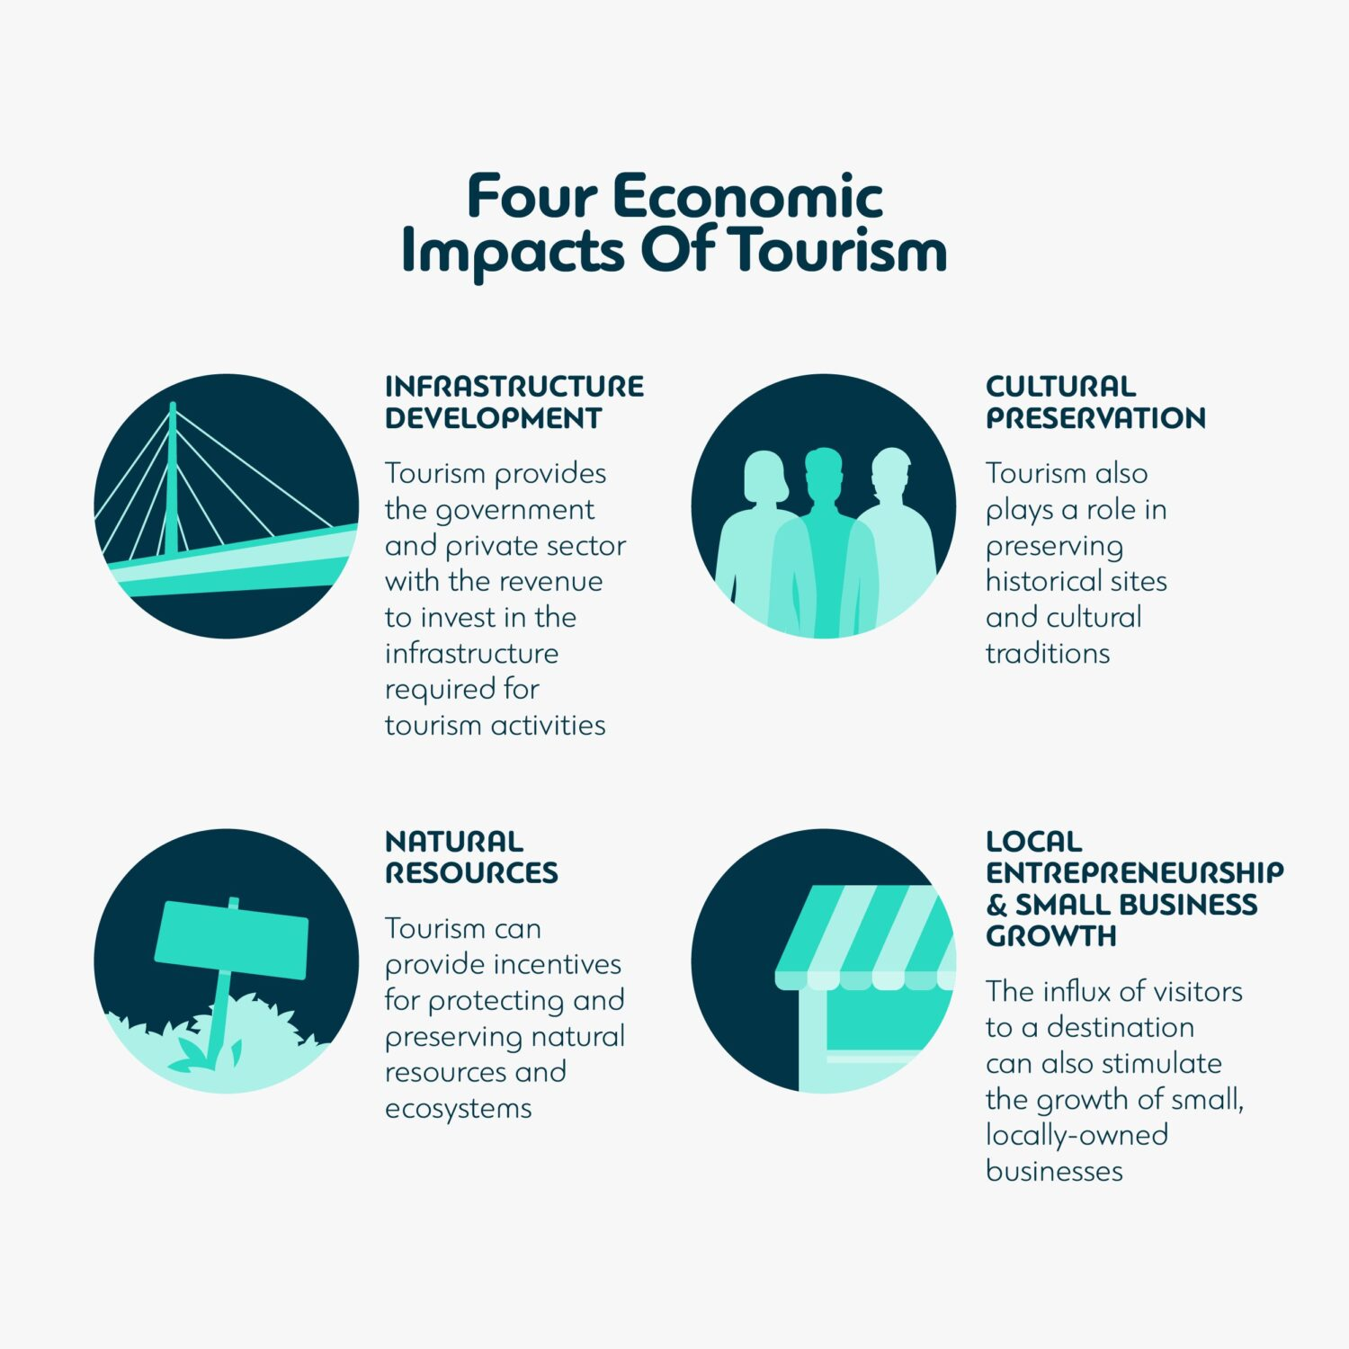
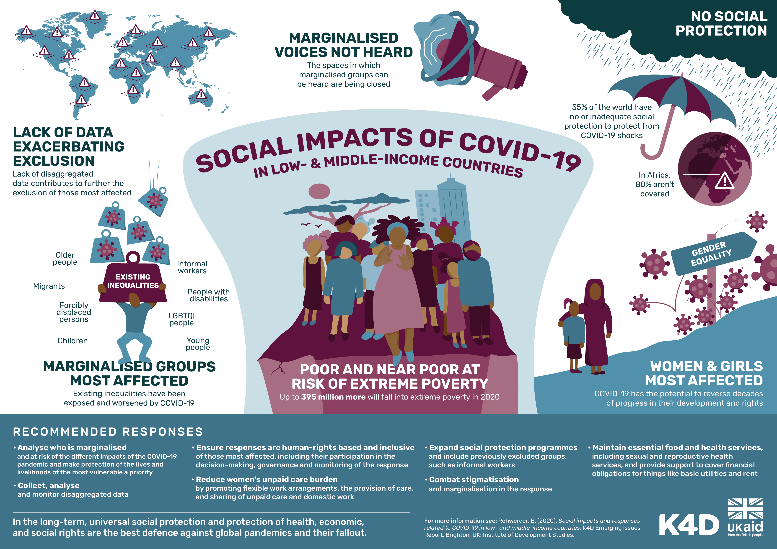
Impacts of Tourism (B1)
Economic Impacts
Negative Impacts: Low-paying jobs, money leakage from the local economy, increased cost of living.
Positive Impacts: Job creation, multiplier effect, foreign currency earnings, contribution to taxes and GDP.
Environmental Impacts
Negative Impacts: Loss of habitats and wildlife, pollution (air, noise, water), overcrowding, environmental degradation.
Positive Impacts: Conservation efforts, environmental education, creation of open spaces, regeneration of urban areas.
Sociocultural Impacts
Negative Impacts: Disruption to daily life, erosion of local culture, increased crime, staged authenticity, exploitation of locals.
Positive Impacts: Improved quality of life, better facilities, enhanced cultural awareness.
Managing Impacts (B3, B4, B5)
Economic Management: Encouraging support for local communities, limiting foreign involvement, and increasing visitor spend within the local economy.
Environmental Management: Visitor and traffic control, responsible planning, resource management, and education to minimize environmental impact
Sociocultural Management: Visitor education, improving infrastructure, community involvement, and economic support to reduce negative social impacts.
Destination Management (C)
Tourism Development (C1)
Tourism Life Cycle Stages: Exploration, involvement, development, consolidation, stagnation, decline/rejuvenation.
Emerging Destinations: Recent popularity, unspoiled features, limited awareness.
Mature Destinations: High tourism volume, developed infrastructure, potential strain on resources.
Government Role (C2)
Reasons for Development: Economic growth, employment, poverty reduction, improving quality of life.
Government Involvement: Legislation, infrastructure development, funding initiatives, sustainable policies.
Influences on Global Travel and Tourism
Sustainable Tourism (B2)
Definition: Sustainable tourism aims to maximize benefits while minimizing negative impacts on local communities, cultures, and the environment.
Goals: Protecting natural resources, offering authentic experiences, and ensuring economic benefits for communities.
Partnerships (C3)
Types of Partnerships: Public-private, private-private, voluntary-private, public-voluntary, destination management organizations.
Advantages: Shared resources, new ideas, cost-sharing, increased visibility.
Disadvantages: Conflicting priorities, slower decision-making, less flexibility.

