Slide 1
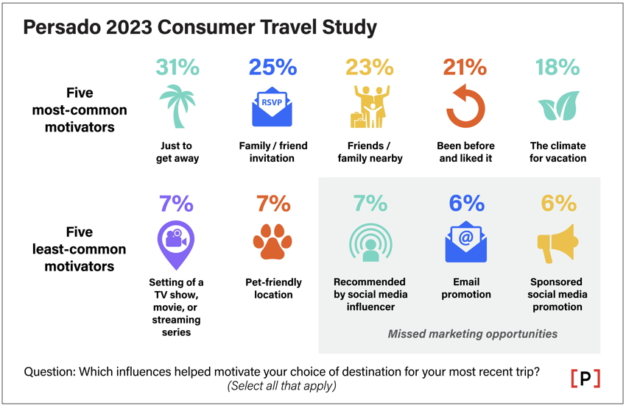
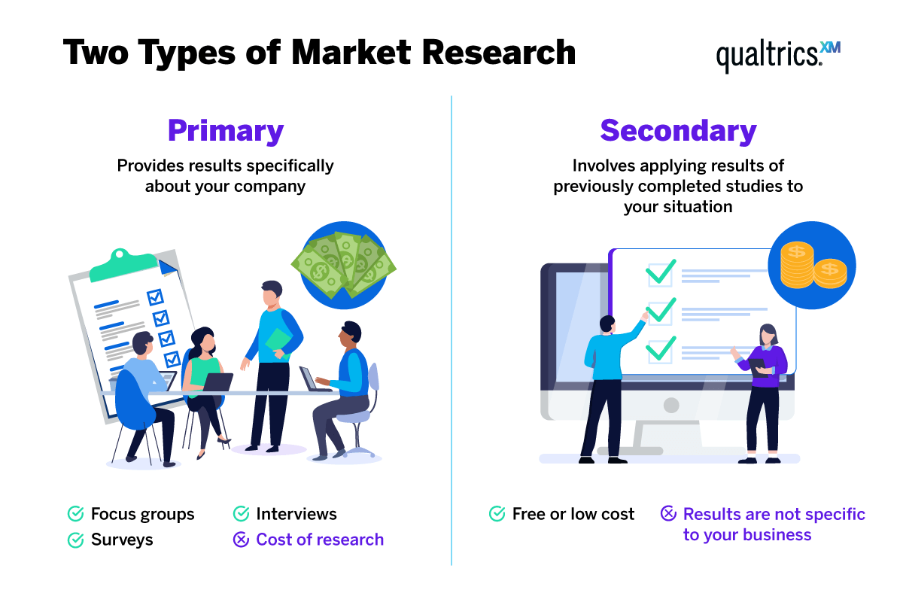
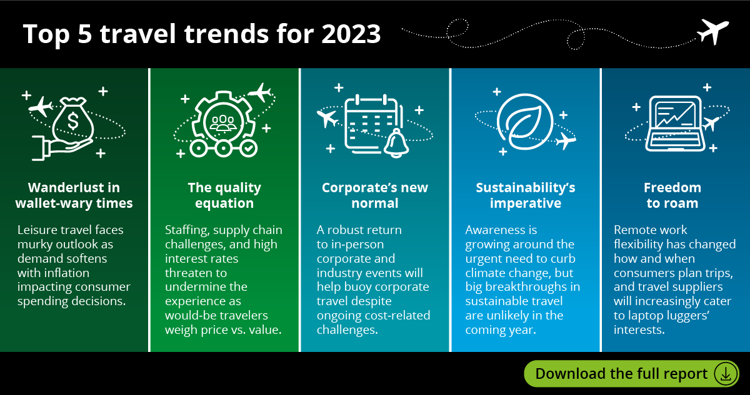
Market Research Types (A1)
Primary Research Methods
Qualitative & quantitative surveys: Face-to-face, telephone, online
Visits/observation: Structured behavior analysis
Interviews, focus groups: Gathering views/experiences
Secondary Research Methods
Online research, books, journals, company reports: Information sourcing
Customer Needs and Preferences (B1)
Travel Needs:
Influences: Dates, accessibility, accommodation, budget, travel purpose, specific/unstated needs
Preferences:
Responsible tourism, convenience, service standards, practical assistance
Meeting Customer Needs (B2)
Provided Services:
Pricing options, customer service, facilities (child-friendly, accessibility, business, health)
Customer Needs in Travel and Tourism
Types of Travel (B3)
Travel Categories:
Leisure, Corporate, Specialist, VFR, Day Trips - each serving different purposes and preferences
Use of Market Research (A2)
Utilization:
Identifying customer types, needs, market segments
Informing product development, ensuring customer satisfaction
Identifying Travel and Tourism Trends (A3)
Trend Identification:
Monitoring visitor numbers, emerging destinations, changing preferences
Travel Planning for Customer Needs (B4)
Planning Steps:
Understanding preferences, sourcing information, detailed travel plans, cost breakdown, essential details

