Slide 1
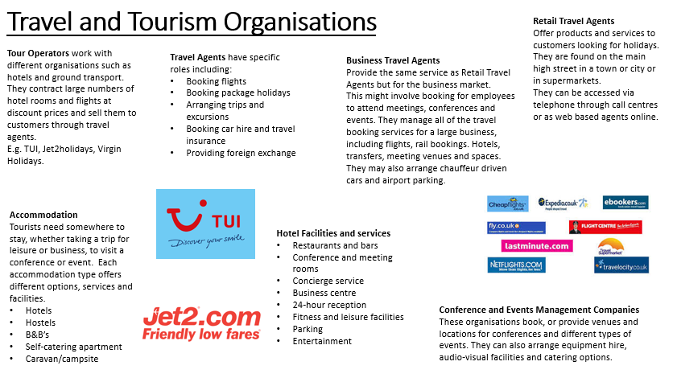
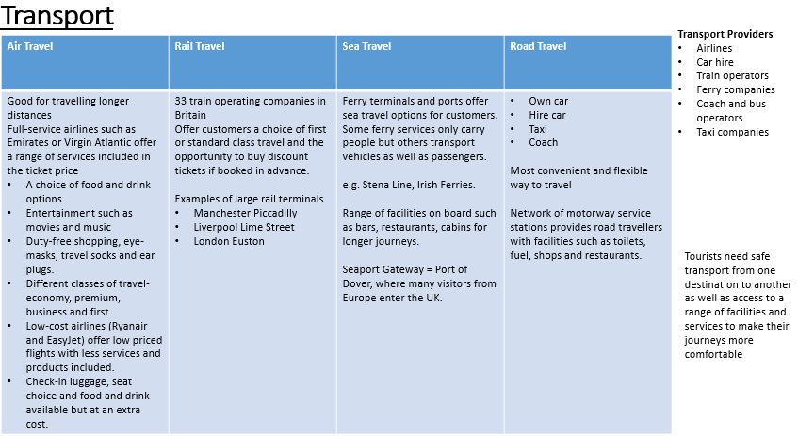
BTEC Travel and Tourism
Component 1
Travel and Tourism organisations and destinations - LOA
Year 9 Term 1

