Slide 1
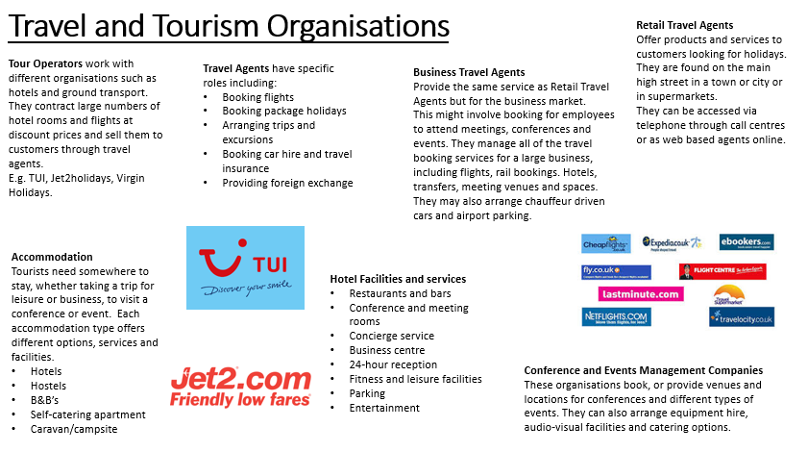
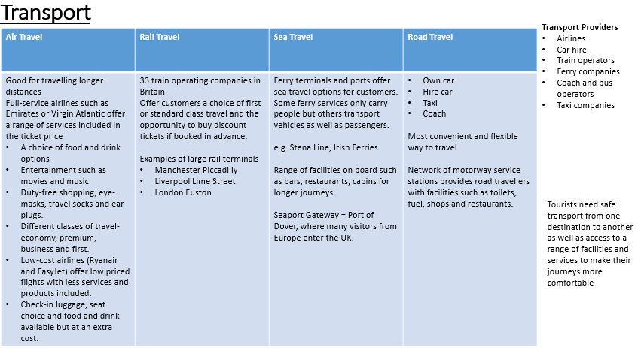
BTEC Travel and Tourism
Component 1
Travel and Tourism organisations and destinations - LOA
Year 9 Term 1

Slide 2
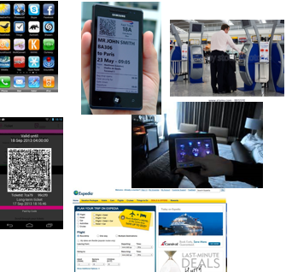
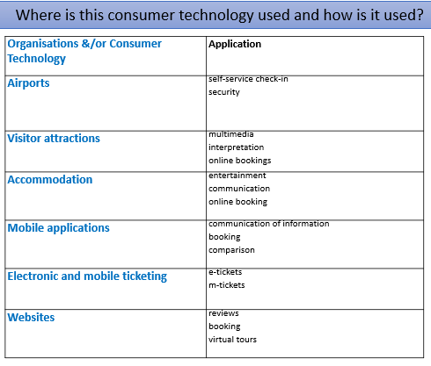
BTEC Travel and Tourism
Component 1
Travel and Tourism organisations and destinations - LOA
Year 9 Term 2/3
A3 Consumer technology
Types of consumer technology
Websites
Voice recognition
Advanced booking systems
Wearable devices
GPS technology
Touch screen
Intelligent keys
Webcams
Internet of things
Virtual reality
Peer to peer
Augmented reality
Artificial intelligence
Advantages –
Convenience, accessibility, data security, cost saving
Disadvantages –
Unreliable devices, alienate key markets, system failure, slow internet speeds, expensive to set up, hacking
Reasons to use
Reach a wider audience
Attract a new market
Efficiency
Improve customer satisfaction
Market research
Remain competitive
A2 Working together
TT organisations working together
Interrelationships
Close relationship between two organisations such as the private and public sectors working together
Interdependencies
Where organisations rely on each other
Ex Joint marketing, reduced admissions to visitor attractions, discounts of local restaurants
Public organisations
Provides public services to benefit local communities. Funded by central, local, regional government.
Provide service, information, education , promotion
Visitor information centres (VICs), Tourist boards, Museums.
Private organisations
There main aim is to make profit. They are controlled by private individuals or shareholders. They maximise sales they increase market share they provide and sell travel/ tourism products and services . Examples include;
Hotels/airlines/theme parks/tour operators
Voluntary organisations
Their main aim is to create social impact rather than make profit. They are run by trustees funded by volunteers and donations. Their aims are to promote, protect, preserve a specific cause, educate and inform, support members, raise awareness. Examples include;
Museums/information centres
Aims
Strategic – These could be sustainability, local community contribution/generating customer loyalty
Financial – These could be to make a profit/increase sales and revenue/increase market share/break even.

Slide 3
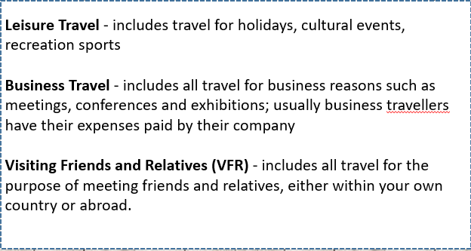
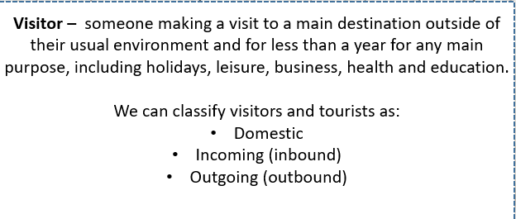
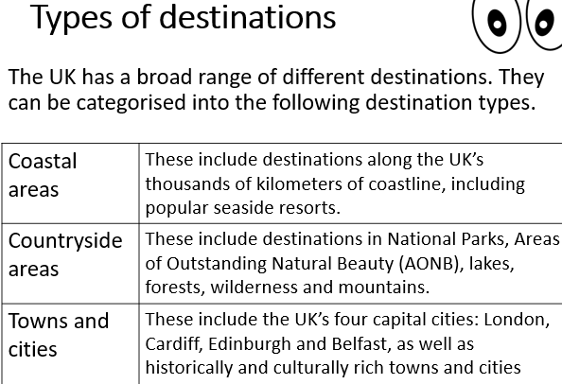
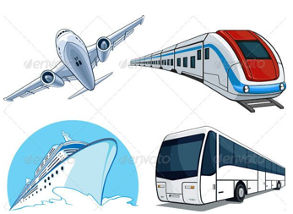
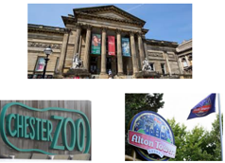
B2 Types of Activities
Types of tourism
Domestic – activities in the country of residence
Inbound – activities of visitors from overseas
Outbound – activities of a visitor outside of their country
Reasons for travel
Leisure - travelling for pleasure, visiting friends and relatives (VFR), relaxation, culture, education, adventure
Business – attending meetings, conferences, exhibitions, training, events.
Year 9 Term 2/3
BTEC Travel and Tourism
Component 1
Travel and Tourism organisations and destinations
LOB
B1 Visitor destinations
Types of destinations
Cities
Cultural
Historic Coastal
Countryside
Features
Natural attractions – features created by nature
Purpose built – built with a specific purpose of attracting visitors – theme parks, water parks
Heritage – appeal due to their historical past
Facilities – used to enhance the experience for the visitor for example; accommodation, transport, shopping, activities
Climate – impacts on activities available and seasonality (High/low seasons)
B3
Popularity of destination with different visitor types
Visitor types
Families
Couples
Individuals
Business – groups, individual
Groups – special interest, friends and family, sports, clubs, educational
B4 Travel options
Transport hubs and gateways
Airports
Bus stations
Ferry/cruise terminal
Railway stations
Modes of transport
Air - (Short/long haul, scheduled, budget, charter, private charter
Rail – regional, national, channel tunnel, overnight,
Sea – ferries, boats, ships
Land -bus, coach, car, taxi
Suitability of travel routes
Departure and arrival points
Dates and times
Length of journey
Cost
Mode of transport
Operators
Services and facilities
Location and duration

