Slide 1
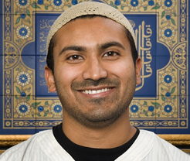
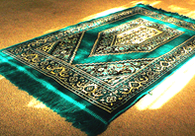
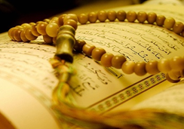
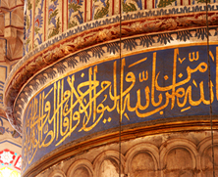
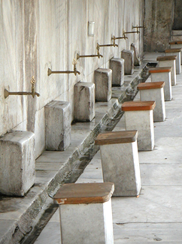
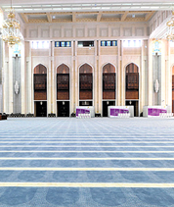
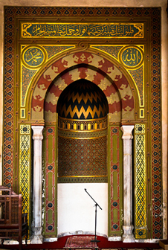
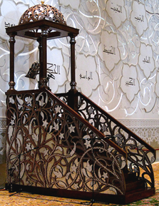
Religion and Worldviews Y7 Summer Term Knowledge Organiser
Introduction to Islam
Items in the Mosque
A mosque is a Muslim holy building. The name comes from the word ‘Masjid’ which is Arabic for ‘place of prostration.’ or ‘place of bowing
down’ to God so can be anywhere where a Muslim prays.
Imam
Prayer Mats
Madrassah
Calligraphy
‘The mosque leader responsible
In the prayer hall, the carpet is
The mosque school where
Beautiful writing to decorate
for the everyday running of the
often marked out with lines for
children are taught how to pray,
the prayer hall with passages of
mosque and the five daily
people to stand within so they
read Arabic and more about
the Qur’an. No pictures of people
prayers.
appropriately spaced for prayer.
Islam.
or animals are allowed.
Wash Room
Prayer Hall
Mihrab
Minbar
Muslims do wudu a special
An empty hall where Muslims
The archway set into the qibla
The platform usually with some
wash to prepare them physically
kneel and touch their foreheads
(front wall of the prayer hall)
steps leading up to it from where
and mentally for prayer. Men and
to the floor during prayer. Men
marking the direction of prayer
the imam delivers his sermon/talk.
women wash separately.
and women pray separately.
towards Makkah in Saudi Arabia.
Retrieval Success Criteria
What items will you find in a mosque?
How is each item in a mosque used?
Why is each item in the mosque important?

Slide 2
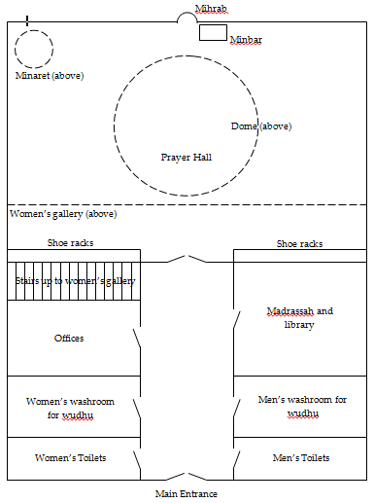
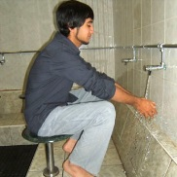
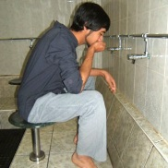
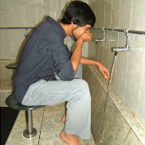
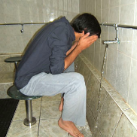
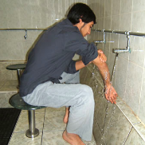
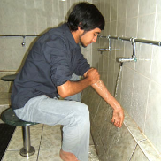
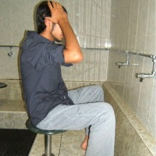
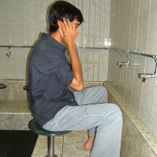
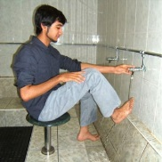
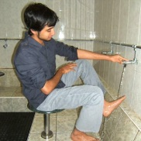
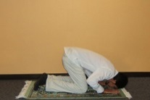
Dome: A rounded roof, shaped like half a ball.
Minaret: A tower attached to a mosque from which the muezzin shouts the call to prayer.
Muezzin: The man who shouts the call to prayer at the mosque.
The Mosque
Muslim Worship
Muslims pray five times a day to their God Allah facing Makkah,
Mihrab/Qibla Wall
Islam’s holy city. This is called Salah and is the second of the five
Minbar
duties a Muslim must perform called ‘the five pillars of Islam.’
Minaret
Muslims can pray anywhere that is clean, but praying with others at
the mosque helps them realise everyone is equal. Muslim men are
expected to attend the mosque on Friday around noon. Shoes are
Dome
removed and heads covered in the mosque to show respect. The
Adhan, Muslim call to prayer is shouted from the minaret to remind
Muslims it is time to pray. Muslims wash before prayer to prepare
themselves physically and mentally. This is called wudu. They wash
Prayer Hall
each part of their body three times in the same order. They wash their:
Shoe racks
Female
Shoe racks
gallery
Stairs to female
gallery
Hands
Mouth
Nose
Face
Right Arm
Madrassah/
Offices
Library
Female
Male
Left Arm
Hair
Ears
Right Foot
Left Foot
Washroom
Washroom
The prayers are accompanied by a set of movements called Rak’ah.
Female
Male
One prayer position is when Muslims prostate
Toilets
Toilets
themselves to their God Allah ensuring only their
palms, knees, toes, forehead and nose are touching
the ground.
Retrieval Success Criteria
What are the main features of the layout
How do Muslims prepare to perform prayer?
Why do Muslims perform prayer as often
of the mosque?
as they do?

Slide 3
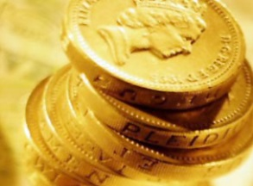
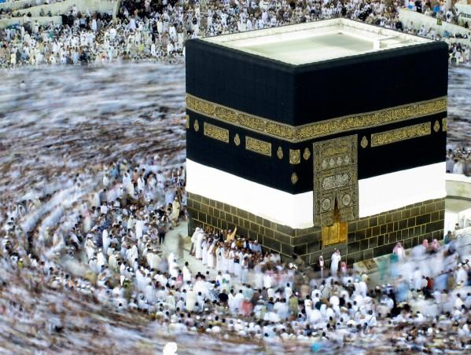
The Five Pillars of Islam
The five pillars of Islam are five duties that every Muslim must satisfy in order to live a good and responsible Muslim life.
Shahadah (Belief)
Makkah, Islam’s holy city.
Believing in one God, Allah and
of Allah.
Salah (Prayer)
Praying five times a day at set
times facing Makkah..
Zakah (Charity)
Giving 2.5% of money a Muslim
Has received and not spent in a
year to the poor.
Sawm (Fasting)
Fasting during Ramadan from
dawn until sunset.
Hajj (Pilgrimage)
Muhammad (pbuh) the messenger
Once in a lifetime journey to Makkah
Shahadah is the first pillar
Salah is the second pillar
Zakah is the third pillar
Sawm is the fourth pillar
Hajj is the fifth pillar of
of Islam. It is statement of
of Islam. It is prayer five
of Islam. It is a form of tax.
of Islam. It is fasting.
Islam. It is a pilgrimage to
faith and most important
times a day to Allah.
It is giving money to
during the month of
Makkah in Saudi Arabia,
Muslim belief. It can be
Muslim belief. It can be
people in need.
Ramadan. Muslims do not
the birthplace of Islam.
translated from Arabic:
Muslims can pray
eat or drink anything from
anywhere that is clean.
dawn to sunset. Ramadan
The Adhan, the Muslim
falls eleven days earlier
call to prayer is shouted
each year. Fasting reminds
into English as:
from the minaret to
Muslims how poor people
‘There is no God but Allah
remind Muslims it is time
feel. Muslims break the
and Muhammad (pbuh) is
to pray. Muslims wash
It amounts to 2.5% of the
fast with a sweet date like
the messenger of Allah’
before prayer called wudu.
money a Muslim has
Prophet Muhammad
and forms part of the Adhan
They wash each part of
received and not spent in
(pbuh) to replenish their
A pilgrimage is a journey
the Muslim call to prayer. It is
their body three times
a year. If a Muslim is too
energy quickly. The fast
made for a religious reason.
whispered in a newborn
in the same order.
poor to give money they
ends with Eid-ul-Fitr, a
It takes place in the twelfth
baby’s ear and where
Prayer is accompanied by.
can perform good deeds
three day celebration to
month of the Muslim
possible it is the last words
a set of movements
instead.
mark the end of fasting.
calendar. Every Muslim must
said by a dying Muslim.
called Rak’ah.
during Ramadan.
complete Hajj once.
Retrieval Success Criteria
What are the five pillars of Islam?
Why are the five pillars of Islam important?
Which of the five pillars of Islam would a
British Muslim find most difficult to follow?

Slide 4
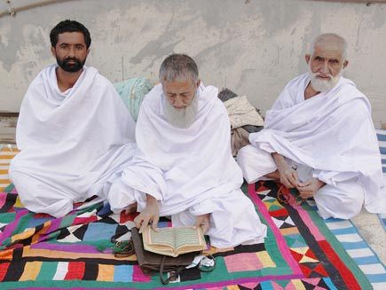
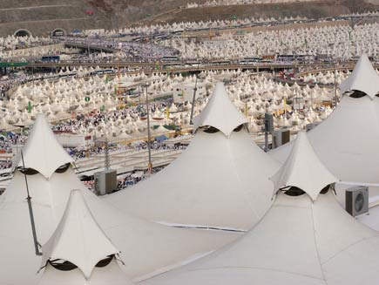
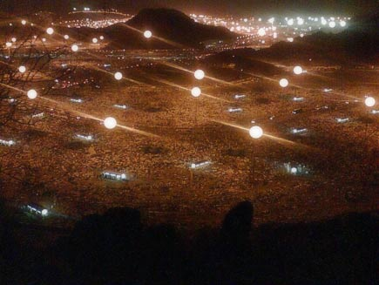
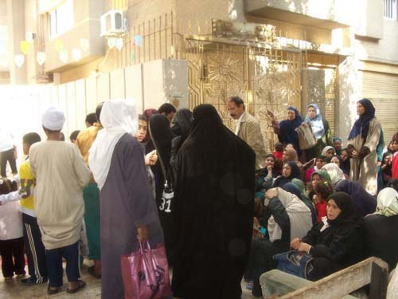
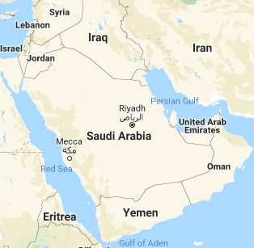
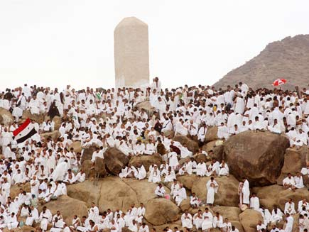
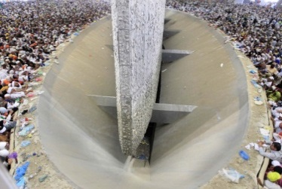
Pilgrimage: A journey made for a religious reason.
Pilgrim: A traveller on a journey to a religious place.
Hajj
Hajj is the fifth pillar of
1
3
5
7
Islam. It is a pilgrimage to
Makkah in Saudi Arabia,
the birthplace of Islam.
It takes place in the twelfth
month of the Muslim
calendar.
On Hajj, all men have to
Pilgrims collect water from
After evening prayers,
Pilgrims buy vouchers for
wear the same clothing:
from the Zam Zam well,
Muslims make their way to
the sacrifice of an animal.
two plain white sheets
then camp out at Mina.
Muzdalifah and spend
The meat from the animal
to show equality.
They meet Muslims from
the night under the stars.
is distributed amongst the
Women may wear any
all over the world and
Muslims then travel to
poor people for Eid-ul-.
modest clothing.
read the Qur’an.
the Jamaraat.
Fitr.
2
4
6
8
Every Muslim who is
Muslims first walk
At dawn, Muslims make
The Jamaraat are three
Pilgrim men then shave
physically and financially
around the Ka’abah, a
their way to the plain of
tall stone pillars that
their heads and women cut
able must complete Hajj
black, cubed shaped
Arafat which reminds
represent Satan.
off a lock of their hair.
once in their lifetime..
building in the mosque
Muslims of the Day of
Pilgrims remember when
This is symbolic of being
Prophet Muhammad
courtyard in Makkah
Judgement when they
Abraham was tempted
cleansed. Pilgrims are now
(pbuh) performed Hajj once
seven times. Pilgrims
will stand before Allah
by Satan not to sacrifice
allowed to wear normal
in his lifetime in memory
then run between Safa and
and be judged. At Arafat
his son Ishmael. Just as
clothes and spend the next
of Prophet Abraham.
Marwa, two hills seven
Muslims spend the full
Abraham resisted the
two or three nights in Mina
Many Muslims choose to
times in memory of Hagar
day praying to Allah and
temptation, Muslims
each day returning to the
visit Medina the place of
Abraham’s wife in her
reflecting on the purpose
symbolically reject Satan
Jamaraat to throw stones.
Prophet Muhammad’s
desperate search for water
of their life.
by throwing stones at
Hajj ends circling the
(pbuh) grave after Hajj.
for their son Ishmael.
the Jamaraat.
Ka’abah again seven times.
Retrieval Success Criteria
What is Hajj?
What do Muslims visit during Hajj?
Why do Muslims do the activities they do
on Hajj?

Slide 5
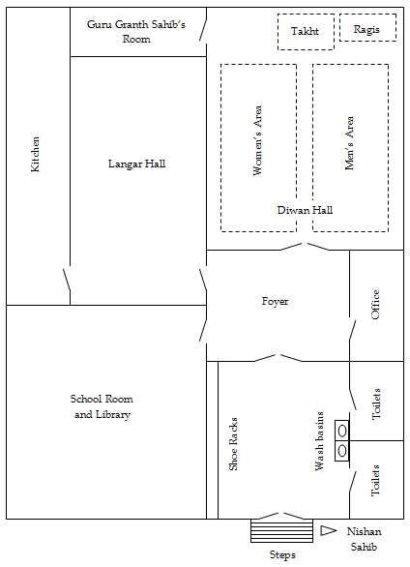
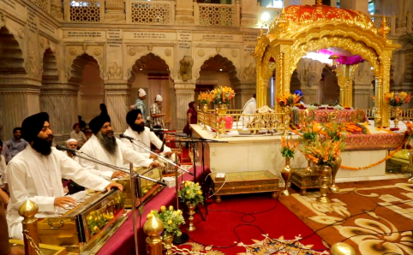
Introduction to Sikhism
God/s
Worship
Founders
How old?
Holy Book
Afterlife
Symbol
Festival
Sikhism
1 God
Gurdwara
Guru Nanak
510
Guru Granth
Reincarnation
Khanda
Baisakhi
Waheguru
Sahib
The Gurdwara
Takht: The raised platform on which the Guru Granth Sahib is placed.
Palki: The canopy above the Guru Granth Sahib.
Guru Granth
Palki
Ragis
Ragis: Musicians who sing/accompany hymns.
Sahib Room
Takht
Diwan Hall: The main prayer hall.
Langar Hall: Dining hall where everyone can share a meal for free.
Nishan Sahib: The orange flag displaying the Sikh symbol.
Sikh Worship
Female Area
Aisle
Kitchen
Male Area
‘Gurdwara’ means ‘guru’s door’ so a gurdwara is God’s house and is.
Langar Hall
anywhere where there is a Guru Granth Sahib. Before
entering the diwan hall Sikhs remove their shoes, cover their head
Diwan Hall
and wash their hands and feet. Sikhs walk down the aisle kneel or
bow and make offerings of money, flowers or food to show respect
to the Guru Granth Sahib. Men and women sit separately. Everyone
Foyer
Office
sits on the floor to show equality.
The Guru Granth Sahib is read to the congregation by the male/
female granthi who waves a fly-whisk or chauri over it as a sign of
respect. Karah prashad, a sweet food made of flour, sugar, milk and
School Room/
water is mixed in a bowl and offered round.
Library
Sikhs perform sewa by serving
Shoe racks
Toilets
Wash basins
others food in the langar hall.
The food is free and anyone Sikh
or not is welcome. The food is
vegetarian, so that no one is left out.
Nishan
Everyone sits on the floor and eats
Steps
Sahib
to show everyone is equal.
Retrieval Success Criteria
What are the main features of the layout
What are the main items used in Sikh
How is equality, a key Sikh teaching, shown
of the gurdwara?
worship?
in the gurdwara?

